Slide 1
The Importance of Narrative in ERM
Stories matter
Frank Ashe
22 May 2019

Slide 2
Introduction
We love stories, I’m spinning a yarn now. In contrast, rational thinking is hard.
Our brain is disposed to listen to stories and to generate them.
It’s much easier to absorb information via a narrative stream that puts in the pegs on which to hang information at the same time as it presents the information.

Slide 3
Introduction
From the point of view of risk management, the dangers are that we don’t understand the information presented because of cognitive overload, or
we realise the inconsistency of two “stories” concerning our company when it is too late.
A strong component of risk management is the dissemination of the pertinent information to the appropriate people.
If the risk analysis can be presented as a more easily understood story, then it should elicit better responses from the recipients

Slide 4
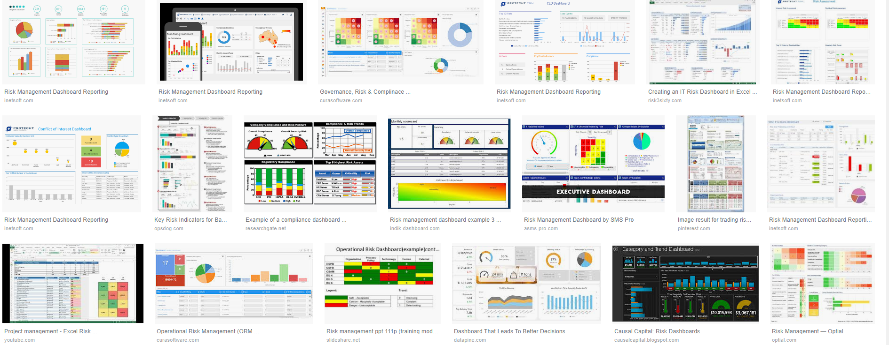
Risk Dashboards?
Examples from Google search on risk management dashboards

Slide 5
Each of these dashboards needs a story
Anybody trying to understand these dashboards has to turn them into a story, done either
Internally, or
Presenter, or
Accompanying prose
Doing it internally presents danger of misinterpretation
Accompanying prose takes time, usually only for condensation to senior executives and Boards.

Slide 6
Economics
Robert Shiller raised the issue in the sphere of economics.
“By narrative economics I mean the study of the spread and dynamics of popular narratives, the stories, particularly those of human interest and emotion, and how these change through time, to understand economic fluctuations.”
…
I use the term narrative to mean a simple story or easily expressed explanation of events that many people want to bring up in conversation or on news or social media because it can be used to stimulate the concerns or emotions of others, and/or because it appears to advance self-interest. To be stimulating, it usually has some human interest either direct or implied. As I (and many others) use the term, a narrative is a gem for conversation, and may take the form of an extraordinary or heroic tale or even a joke. It is not generally a researched story, and may have glaring holes, as in “urban legends.”
(Shiller Narrative Economics 2017)

Slide 7
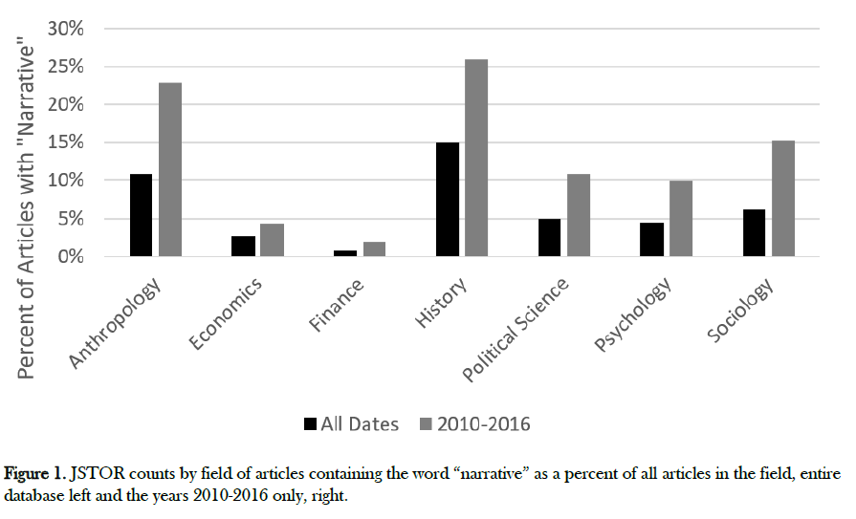
(Shiller Narrative Economics 2017)

Slide 8
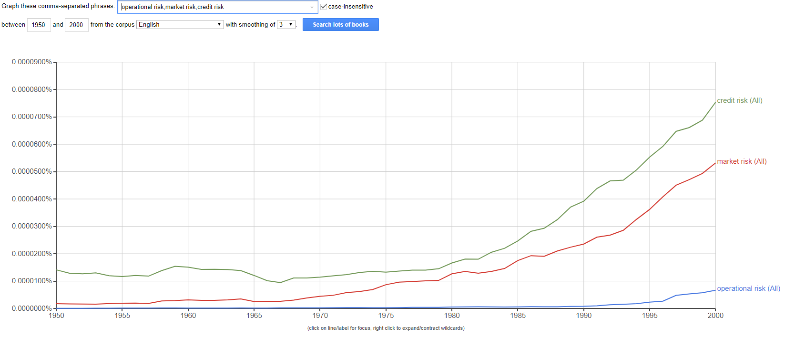
Ngram of the 3 main risks in finance

Slide 9
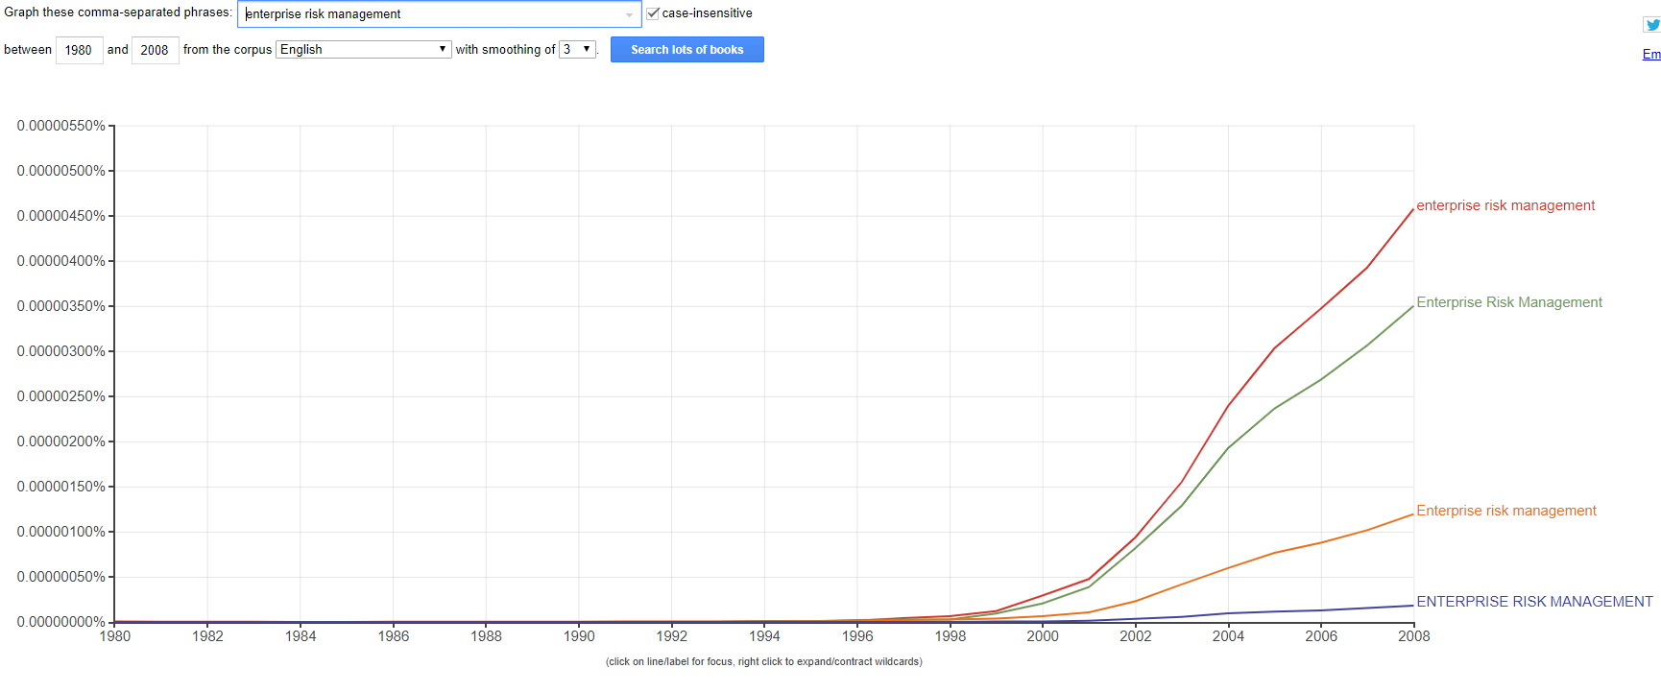
Ngram ERM

Slide 10
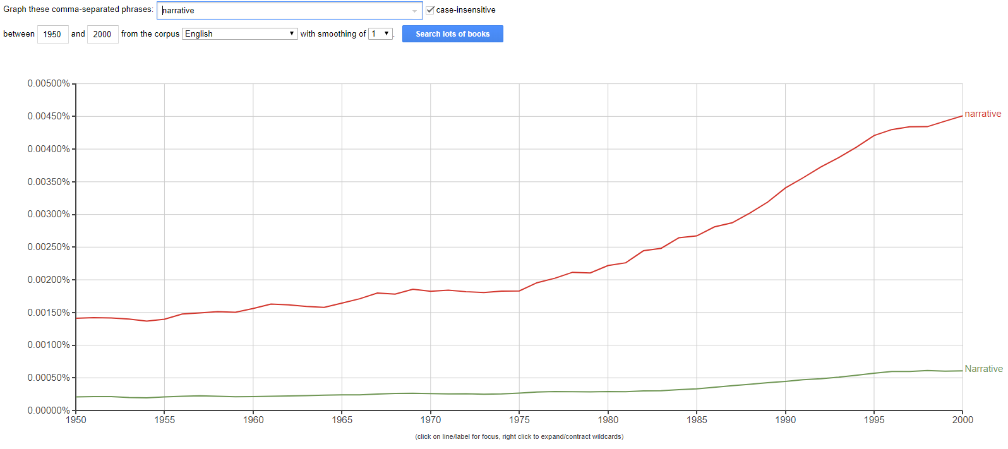
Narrative is becoming more commonly discussed

Slide 11
Narrative and business

Slide 12
Narrative psychology
“As I see it, the concept of narrative should focus on how narrative works to create meanings. I take this to be the principal mission of narrative, basic to what makes it such an attractive concept. Narrative allows researchers insight into the process of meaning making.”
(Schiff The Function of Narrative: Toward a Narrative Psychology of Meaning 2012)
Narrative psychology is the view that human nature is fundamentally tied to stories.

Slide 13
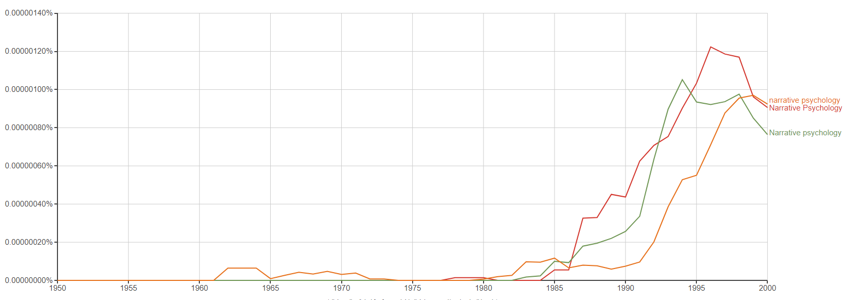
“Narrative psychology” has taken off
The importance of narrative within the psychology of a person has achieved more importance.

Slide 14
Narrative and evolution
The prefrontal cortex (pFC), the newest part of the brain in an evolutionary sense, is sometimes called the "executive" region, because it draws inputs from almost all other regions, integrates them to form near and long-term goals, and plans actions that take these goals into account.
Part of its processing for this is to spin a story about the world. Here’s a quote from Gazzaniga[1], one of the long-term investigators in this area.

Slide 15
Narrative and Evolution (ii)
Gazzaniga (1989, 1995) and Metcalfe et al. (1995) have hypothesized the existence of an interpreter that plays the role of trying to make sense out of the information that it confronts, in other words, generating causal hypotheses. Using split-brain patients, Gazzaniga (1995) provided evidence that this interpreter is located in the left hemisphere in most individuals. The simultaneous concept test provides an example of the function of the interpreter. In this task, a split-brain patient is shown a picture exclusively to the left hemisphere (e.g., a chicken) and another picture exclusively to the right hemisphere (e.g., a snow scene). The patient is then given an array of pictures and asked to point to a picture associated with the presented pictures. In the above example, the left hemisphere chose a chicken claw, and the right hemisphere chose a shovel. When asked to explain the choices, the patient responded, "Oh, that's simple. The chicken claw goes with the chicken, and you need a shovel to clean out the chicken shed." The right hemisphere is unable to produce speech, so it cannot explain its selection. The left hemisphere is unaware of the picture that the right hemisphere is responding to (i.e., the snow scene), so it must generate its own interpretation of why the left hand pointed to a shovel. The left hemisphere, observing the actions of the left hand and right brain, interprets those actions within the context of what it knows (i.e., a chicken claw) and generates an explanation for the shovel that is consistent with its knowledge (Gazzaniga, 1989).

Slide 16
Presenting information
Presenting information in a narrative structure significantly enhances its ability to be remembered.
Narrative processing is a universal human trait[2] and the forms that it takes are also universal.
Gazzaniga’s interpreter that tries to make sense out of the information it confronts is spinning a tale about the world – this happened because of that, and then he did this, and she did that, and so on and so on.

Slide 17
Presenting information (ii)
And because people are such an important part of the environment for a social species such as ourselves, many of the interpretations of the world come attached with hypotheses concerning the mental state of the actors – why did she do this, why didn’t he stop that happening?[3]
Two very strong messages come out of this for the risk management realm:
if information is presented in a coherent narrative then it will be much more easily believed;
we have a tendency to anthropomorphise too readily.

Slide 18
Dissonance
The risk management realm is far from certain.
If somebody can tell a simple story, for example what are macro trends, and this accords with some of the information we have seen, then the story is believable.
Another person can come along and tell a story about different macro trends, and this can rely on some observations we have made ourselves as well, the story is believable.

Slide 19
Dissonance (ii)
It sometimes takes cognitive effort to realise that the two stories are contradictory.
When we realise the contradiction, we feel sick.
What happens if we don’t realise the stories are contradictory
Don’t think this won’t happen to you!
If you think this then you are in great danger of falling for other cognitive biases!

Slide 20
Contradictory information
Research by Drew Westen at Emory University[4] uses fMRI to see what happens when we come across information that does not accord with a pre-existing story we’ve believed. The US study took ardent Democrats and Republicans in the 2004 presidential elections and, while in the machine, presented them with TV clips of both candidate saying something contradictory, a common event on the campaign trail under the pressure of electioneering. The opposing party was recognised as being contradictory, but both Democrats and Republicans interpreted their candidate in a favourable light.

Slide 21
Contradictory information (ii)
When assessing the favoured candidate the rational part of the brain was not engaged. The parts of the brain associated with the processing of emotions, conflict resolution, and making judgements about moral accountability were all active, and this is associated with a feeling of discomfort. When a conclusion had been reached with which the subject was comfortable, the ventral striatum kicked in – the region of the brain associated with reward and pleasure. As Westen said “Essentially, it appears as if partisans twirl the cognitive kaleidoscope until they get the conclusions they want, and then they get massively reinforced for it, with the elimination of negative emotional states and activation of positive ones.”

Slide 22
Contradictory information (iii)
The reinforcement comes from mentally resolving the contradiction, not necessarily correctly.
Our default mechanism is to reinterpret the information until it fits our preconception – we resolve the cognitive dissonance.
This is not a good thing!
Get the information into a narrative to mitigate the effect of the preconceptions.

Slide 23
Contradictory information (iv)
Complementing this result is research by Fugelsang et al[5] that shows that the neurological pathways involved in the first level of processing of information depends on whether the information being presented is consistent or inconsistent with our prior beliefs.
Inconsistent information follows the pathway outlined in the previous paragraph. Consistent information lights up brain regions associated with memory and learning.
Note that there is no default control over which process is in place. There is automatic streaming taking place before conscious thought has a chance to kick in.

Slide 24
Contradictory information (v)
As Fugelsang et al^{[6]} , and Heuer^{[7]} note, there are procedures available which help to reduce this innate bias – presentation of disconfirming information, reminding people that bias is possible - and many of these techniques are already used in business.
What this research shows us is how pervasive is the biasing process. Our balancing mechanisms need to be potentially active at all decision levels to ensure optimum performance – with adjustment for the cognitive and real costs of the checks and balances.
Making a narrative is an additional method, and can include these ideas.

Slide 25
Footnotes
^{[1]} Wolford, Miller and Gazzaniga - The Left Hemisphere's Role in Hypothesis Formation (2000)
^{[2]} Sugiyama - Narrative Theory and Function: Why Evolution Matters (2001)
^{[3]} For an introductory analysis of the implications of all this psychology on most people’s usual view of communication, which is usually a naïve blend of Locke’s original 1690 view and Shannon’s 1949 mathematical view of communication, see Radford - On the Philosophy of Communication (2005) Needless to say, things get more complicated than simply Who, Says What, Through which Channel, to Whom, with What Effect.
^{[4]} Discussed in Shermer - The Political Brain (2006)
^{[5]} Fugelsang and Dunbar - A cognitive neuroscience framework for understanding causal reasoning and the law (2004)
^{[6]} ibid.
^{[7]} Heuer Jr. - Psychology of Intelligence Analysis (1999)

Slide 26
What to do?
Narrative is also involved in systemic risk, where bubbles and their bursting are linked to narratives, and a loss of trust in a marketplace can be spread by a superficially plausible, but incorrect, narrative.
Further, the ESG framework has spread because of a surrounding narrative that fits a social trend in other areas of the economy.
A CRO needs to understand the importance of narrative in areas such as corporate culture - especially risk culture – strategic risk, governance, and communication.

Slide 27
What to do?
This talk is too short to cover the issue
Narrative is what allows us to understand lots of complex information
Look at The Odyssey to see how complex information can be told in a complex fashion yet still be eminently understandable and enjoyable – and that was 3,000 years ago
Risk management does not use enough narrative in its most important job – communication
Turn your dashboards into stories
The bigger the risk, the more a story is needed – corporate strategy is the biggest risk, so needs the best story

