Slide 1
An individual risk model for premium calculation based on quantile:
a comparison between Generalized Linear Models and Quantile Regression
Fabio Baione, Davide Biancalana
22 May 2019

Slide 2
Agenda
A brief introduction on…myself!
Motivation
  Quantile
  Regression
References on QR in Actuarial context
Risk Model
Premium Principles
Ratemaking
  GLM
  QR
Pros and cons
Further researches and conclusions

Slide 3
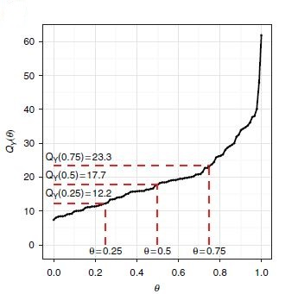



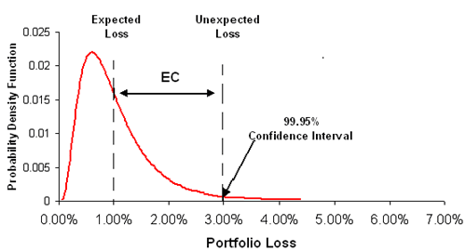
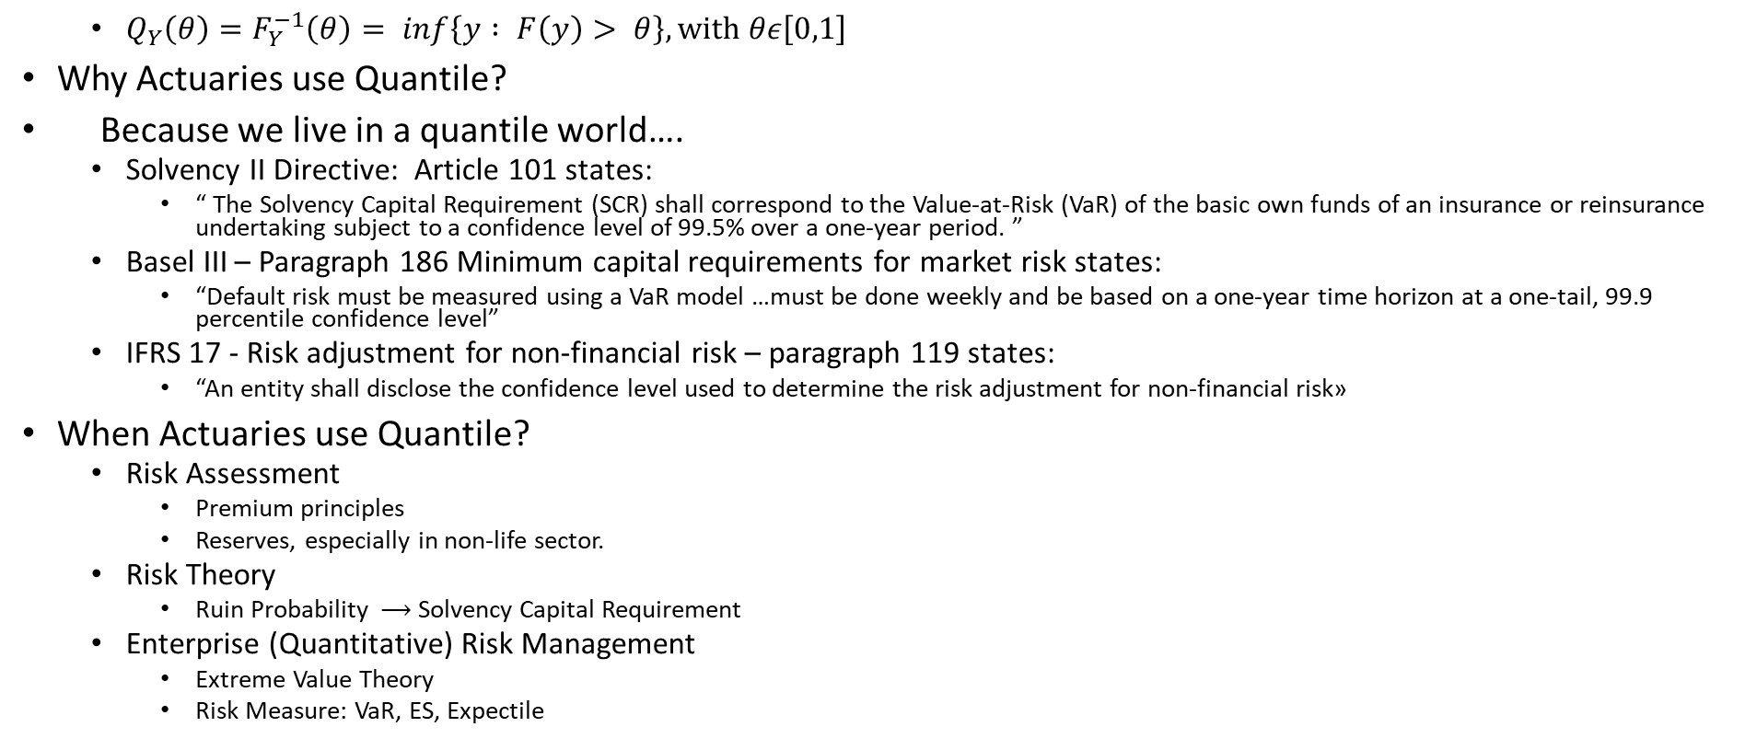
Motivation….
  $Q_{Y}\left(θ\right)=F_{Y}^{−1}\left(θ\right)= inf\left\{y : F\left(y\right)> θ\right\}, with θε\left[0,1\right]$
Why Actuaries use Quantile?
Because we live in a quantile world….
  Solvency II Directive: Article 101 states:
    “ The Solvency Capital Requirement (SCR) shall correspond to the Value-at-Risk (VaR) of the basic own funds of an insurance or reinsurance undertaking subject to a confidence level of 99.5% over a one-year period. ”
  Basel III – Paragraph 186 Minimum capital requirements for market risk states:
    “Default risk must be measured using a VaR model …must be done weekly and be based on a one-year time horizon at a one-tail, 99.9 percentile confidence level”
  IFRS 17 - Risk adjustment for non-financial risk – paragraph 119 states:
    “An entity shall disclose the confidence level used to determine the risk adjustment for non-financial risk»
When Actuaries use Quantile?
  Risk Assessment
    Premium principles
    Reserves, especially in non-life sector.
  Risk Theory
    Ruin Probability $⟶$ Solvency Capital Requirement
  Enterprise (Quantitative) Risk Management
    Extreme Value Theory
    Risk Measure: VaR, ES, Expectile
The compensation an entity requires for bearing the uncertainty about the amount and timing of the cash flows that arises from non-financial risk as the entity fulfils insurance contracts.
“The devil is in the tails” Donnelly & Embrechts

Slide 4
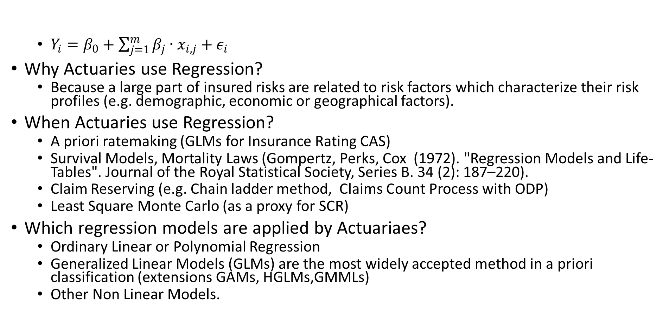
Motivation….
  $Y_{i}=β_{0}+\sum_{j=1}^{m}{β_{j}∙x_{i,j}}+ε_{i}$
Why Actuaries use Regression?
  Because a large part of insured risks are related to risk factors which characterize their risk profiles (e.g. demographic, economic or geographical factors).
When Actuaries use Regression?
  A priori ratemaking (GLMs for Insurance Rating CAS)
  Survival Models, Mortality Laws (Gompertz, Perks, Cox (1972). "Regression Models and Life-Tables". Journal of the Royal Statistical Society, Series B. 34 (2): 187–220).
  Claim Reserving (e.g. Chain ladder method, Claims Count Process with ODP)
  Least Square Monte Carlo (as a proxy for SCR)
Which regression models are applied by Actuariaes?
  Ordinary Linear or Polynomial Regression
  Generalized Linear Models (GLMs) are the most widely accepted method in a priori classification (extensions GAMs, HGLMs,GMMLs)
  Other Non Linear Models.

Slide 5
References of QR applied to the Actuarial context
Widely used in statistics and econometrics, while there are very few applications in actuarial field.
To the best of our knowledge:
  Ratemaking
    (2009) Kudryavtsev, A. A., 2009. Using quantile regression for ratemaking. Insurance: Mathematics and Economics 45, 296-304
    (2010) Fu, L. and Cheng-sheng Wu, P. Applications of Quantile Regression in Commercial Underwriting Models https://www.casact.org/education/rpm/2010/handouts/CL1-Fu.pdf
    (2014) Wolny-Dominiak, A., Ornat-Acedaska, A., Trzpiot G., 2012. Insurance portfolios rate making: Quantile regression approach, Proceedings of 30th International Conference Mathematical Methods in Economics
    (2018) Heras A. Moreno I. Vilar-Zanon J.L. An application of two-stage quantile regression to insurance ratemaking, Scandinavian Actuarial Journal, 2018 (9) pp.753-769
    (2019) Baione, F., Biancalana D.,. An individual risk model for premium calculation based on quantile:
    a comparison between Generalized Linear Models and Quantile Regression, to be pusblished in North American Actuarial Journal
  Solvency 2
    Pitselis, G., Solvency supervision based on a total balance sheet approach, Journal of Computational and Applied Mathematics 233(1): 83-96
  Credibility Theory
    (2013) Pitselis, G. «Quantile credibility models» Insurance: Mathematics and Economics Volume 52, Issue 3, May 2013, Pages 477-489
  Claims Reserving
    (2014) Risk Margin Quantile Function Via Parametric and Non-Parametric Bayesian Quantile Regression, arXiv:1402.2492.

Slide 6
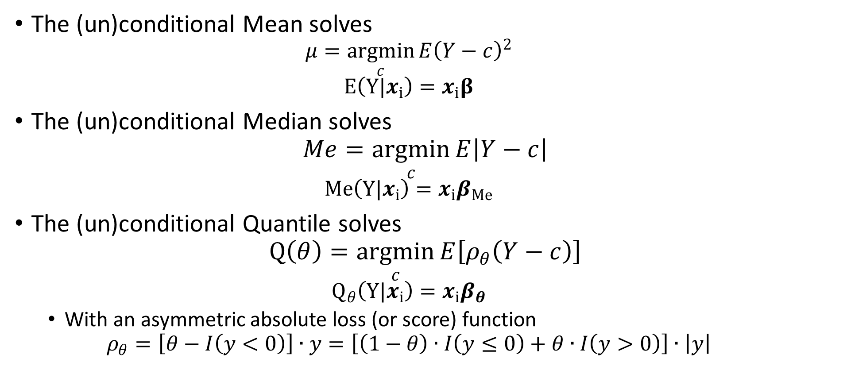
Quantile Regression
Koenker and Bassett (1978)
The (un)conditional Mean solves
  $$μ=\underset{c}{argmin}{E{\left(Y−c\right)}^{2}}$$
  $$E\left(Y|x_{i}\right)=x_{i}β$$
The (un)conditional Median solves
$$Me=\underset{c}{argmin}{E\left|Y−c\right|}$$
  $$Me\left(Y|x_{i}\right)=x_{i}β_{Me}$$
The (un)conditional Quantile solves
$$Q\left(θ\right)=\underset{c}{argmin}{E\left[ρ_{θ}\left(Y−c\right)\right]}$$
  $$Q_{θ}\left(Y|x_{i}\right)=x_{i}β_{θ}$$
  With an asymmetric absolute loss (or score) function
  $$ρ_{θ}=\left[θ−I\left(y<0\right)\right]∙y=\left[\left(1−θ\right)∙I\left(y≤0\right)+θ∙I\left(y>0\right)\right]∙\left|y\right|$$

Slide 7
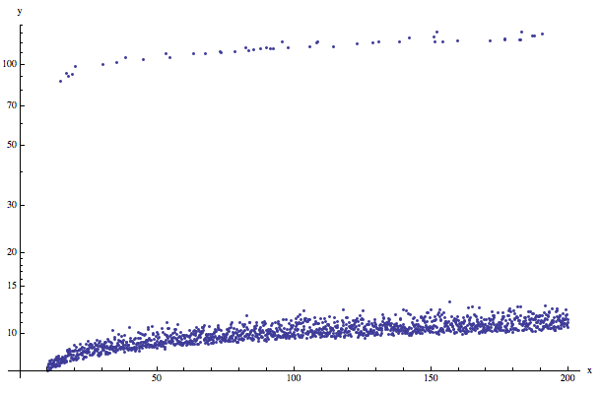
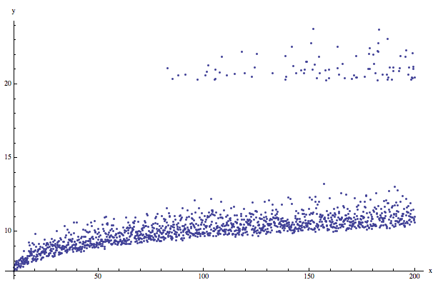
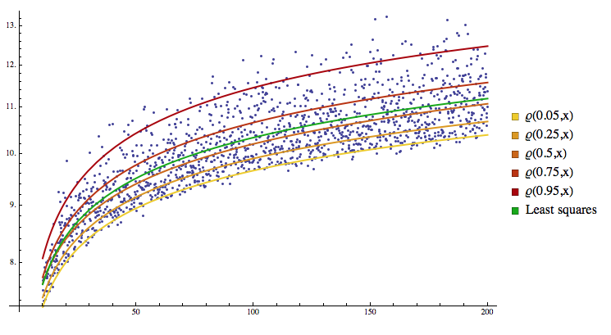
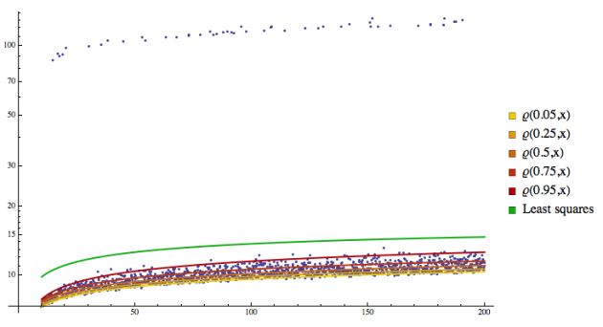
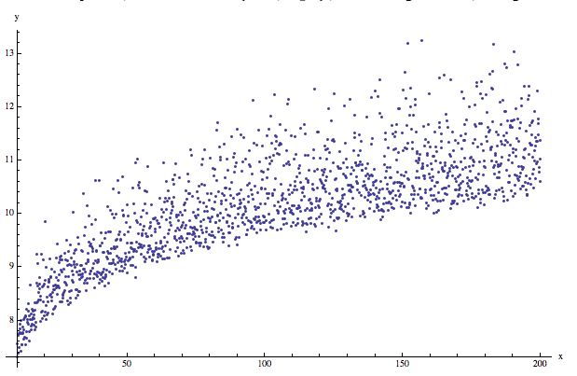
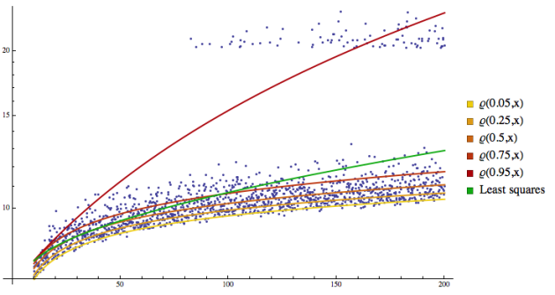
QR is robust to outliers: an example

Slide 8
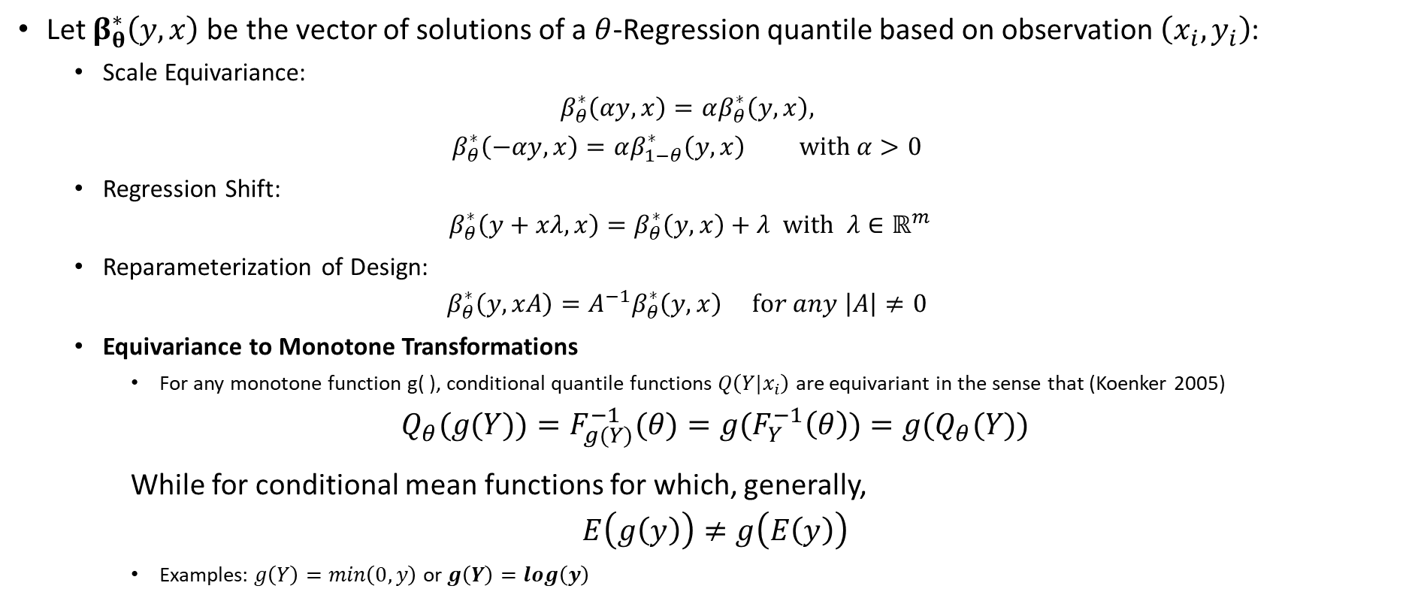
QR Equivariance properties
Let $β_{θ}^{∗}\left(y,x\right)$be the vector of solutions of a $θ$-Regression quantile based on observation $\left(x_{i},y_{i}\right)$:
  Scale Equivariance:
  $$β_{θ}^{∗}\left(αy,x\right)=αβ_{θ}^{∗}\left(y,x\right),$$
  $$β_{θ}^{∗}\left(−αy,x\right)=αβ_{1−θ}^{∗}\left(y,x\right) with α>0$$
  Regression Shift:
  $$β_{θ}^{∗}\left(y+xλ,x\right)=β_{θ}^{∗}\left(y,x\right)+λ with λ∈ℝ^{m}$$
  Reparameterization of Design:
  $$β_{θ}^{∗}\left(y,xA\right)=A^{−1}β_{θ}^{∗}\left(y,x\right) for any \left|A\right|≠0$$
  Equivariance to Monotone Transformations
    For any monotone function g( ), conditional quantile functions $Q\left(Y|x_{i}\right)$ are equivariant in the sense that (Koenker 2005)
$$Q_{θ}(g(Y))=F_{g(Y)}^{−1}(θ)=g(F_{Y}^{−1}\left(θ\right))=g(Q_{θ}(Y))$$
While for conditional mean functions for which, generally,
$$E\left(g\left(y\right)\right)≠g\left(E\left(y\right)\right)$$
    Examples: $g\left(Y\right)=min\left(0,y\right)$ or $g\left(Y\right)=log\left(y\right)$

Slide 9
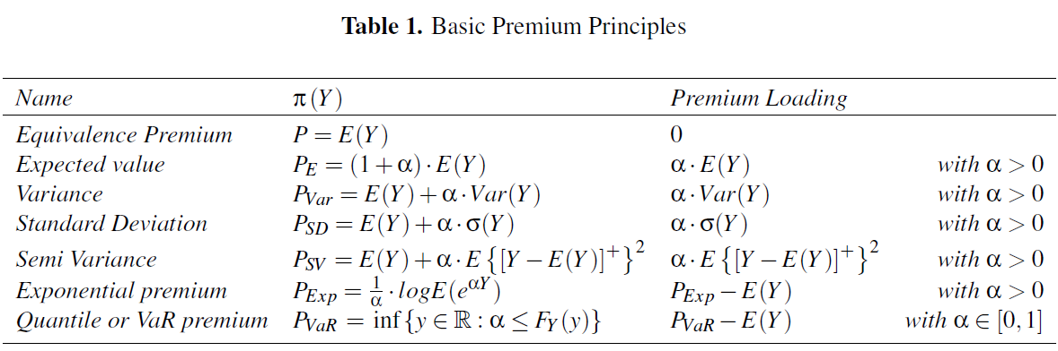
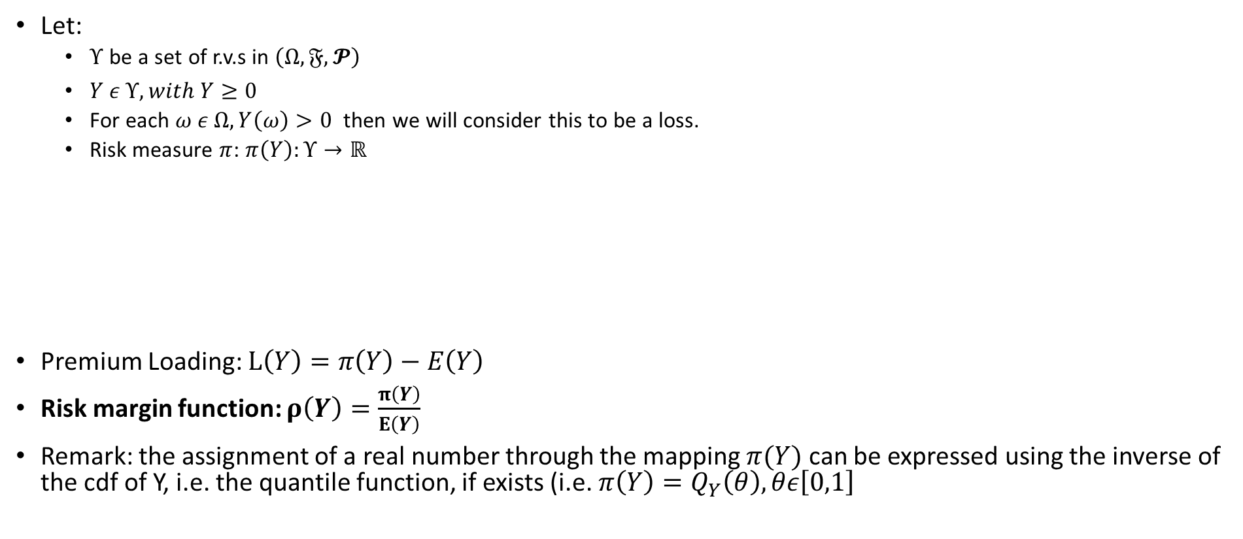
Basic Premium Principles
Let:
  $Υ$ be a set of r.v.s in $\left(Ω,𝔉,𝓟\right)$
  $Y ε Υ, with Y≥0$
  For each $ω ε Ω, Y\left(ω\right)>0$ then we will consider this to be a loss.
  Risk measure $π$: $π\left(Y\right):Υ→ℝ$
Premium Loading: $L\left(Y\right)=π\left(Y\right)−E\left(Y\right)$
Risk margin function: $ρ\left(Y\right)=\frac{π\left(Y\right)}{E\left(Y\right)}$
Remark: the assignment of a real number through the mapping $π(Y)$ can be expressed using the inverse of the cdf of Y, i.e. the quantile function, if exists (i.e. $π\left(Y\right)=Q_{Y}\left(θ\right), θε\left[0,1\right]$

Slide 10
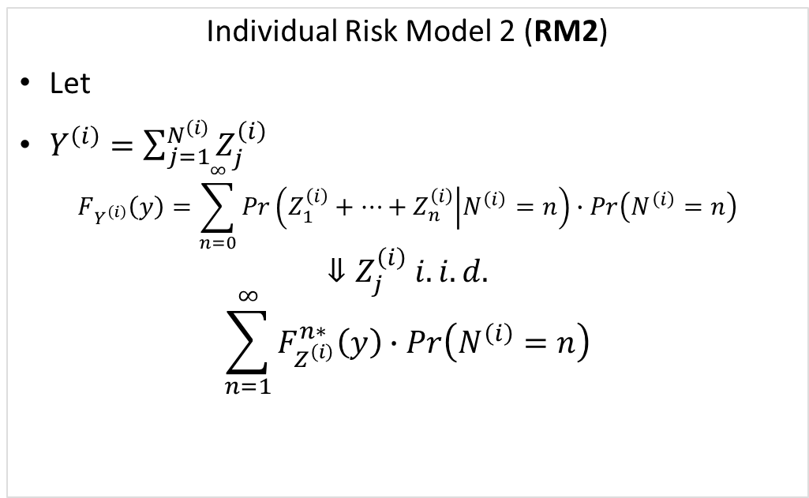
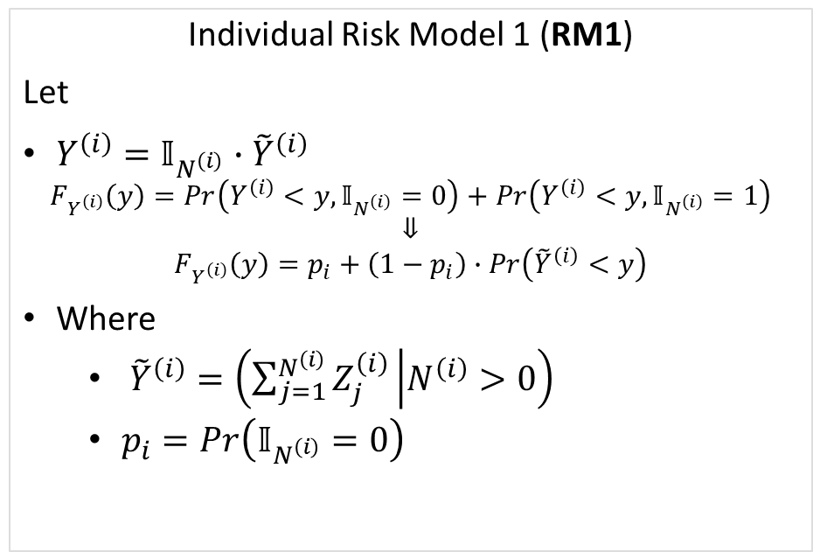

Two-part models for insurance ratemaking
Collective risk model - The total loss of the portfolio
$$Y=\sum_{i=1}^{r}{Y^{\left(i\right)}}=\sum_{k=1}^{N}{Z_{k}}=\sum_{i=1}^{r}{\sum_{j=1}^{N^{\left(i\right)}}{Z_{j}^{\left(i\right)}}}$$
Individual Risk Model 1 (RM1)
Let
$Y^{\left(i\right)}=𝕀_{N^{\left(i\right)}}∙{\tilde{Y}}^{\left(i\right)}$
$$F_{Y^{\left(i\right)}}\left(y\right)=Pr\left(Y^{\left(i\right)}<y,𝕀_{N^{\left(i\right)}}=0\right)+Pr\left(Y^{\left(i\right)}<y,𝕀_{N^{\left(i\right)}}=1\right)$$
$$⇓$$
$$F_{Y^{\left(i\right)}}\left(y\right)=p_{i}+\left(1−p_{i}\right)∙Pr\left({\tilde{Y}}^{\left(i\right)}<y\right)$$
Where
  ${\tilde{Y}}^{\left(i\right)}=\left(\sum_{j=1}^{N^{\left(i\right)}}{Z_{j}^{\left(i\right)}} | N^{\left(i\right)}>0\right)$
  $p_{i}=Pr\left(𝕀_{N^{\left(i\right)}}=0\right)$
Individual Risk Model 2 (RM2)
Let
$Y^{\left(i\right)}=\sum_{j=1}^{N^{\left(i\right)}}{Z_{j}^{\left(i\right)}}$
$$F_{Y^{\left(i\right)}}\left(y\right)=\sum_{n=0}^{∞}{Pr\left(Z_{1}^{\left(i\right)}+⋯+Z_{n}^{\left(i\right)} | N^{\left(i\right)}=n\right)}∙Pr\left(N^{\left(i\right)}=n\right)$$
$$⇓Z_{j}^{\left(i\right)} i.i.d.$$
$$\sum_{n=1}^{∞}{F_{Z^{\left(i\right)}}^{n∗}\left(y\right)}∙Pr\left(N^{\left(i\right)}=n\right)$$

Slide 11
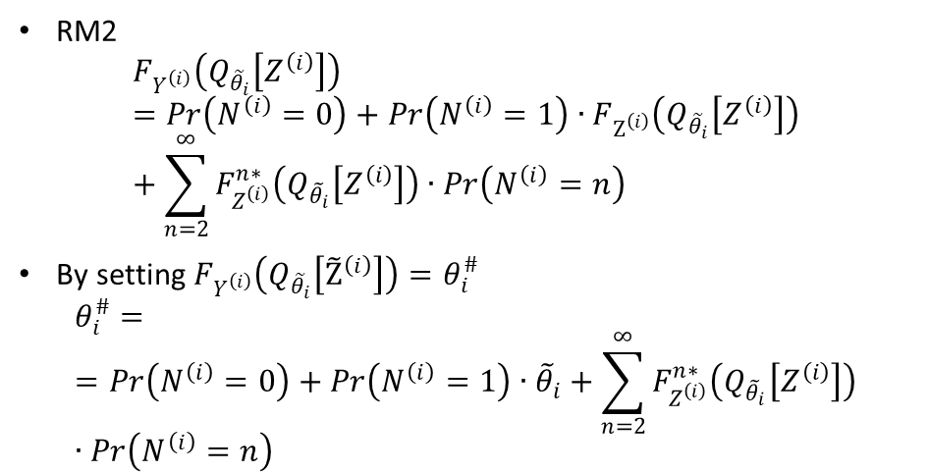
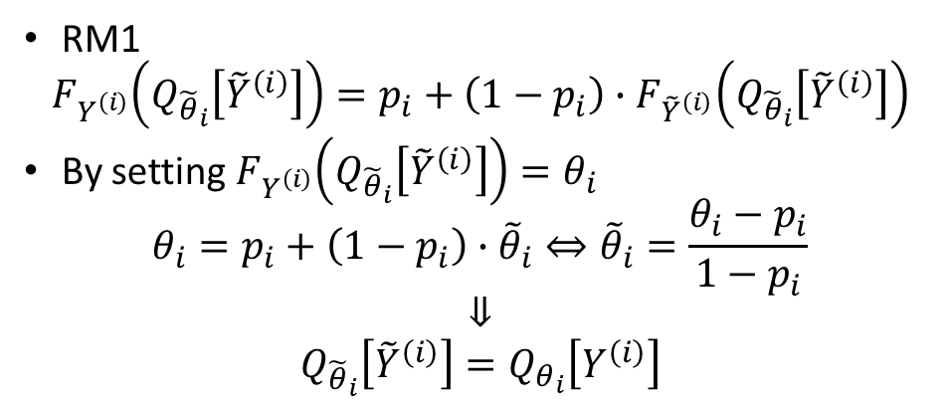
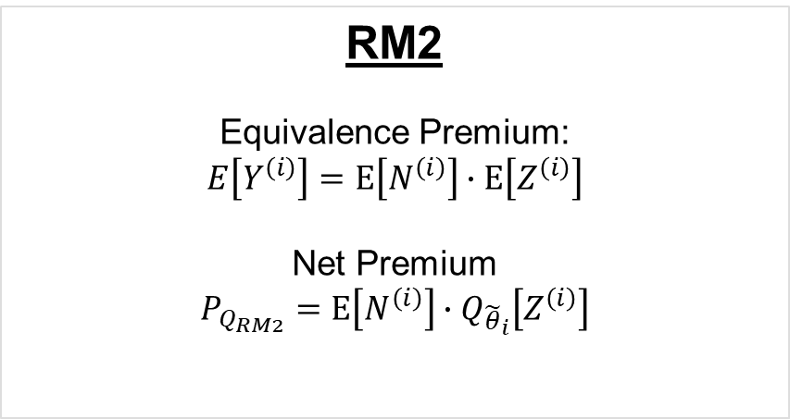
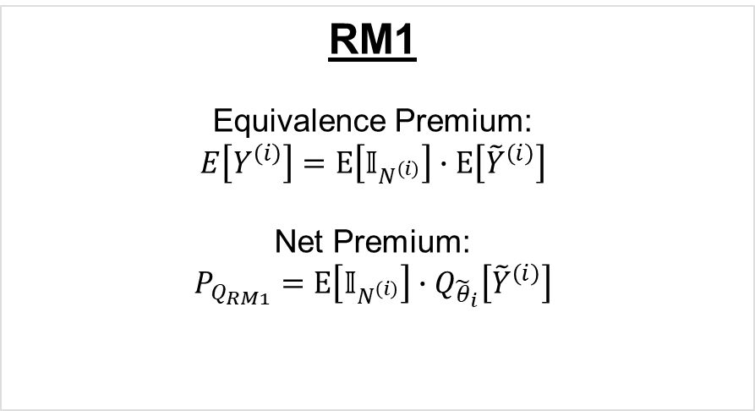
A quantile premium principle based on a two-part model
RM1
$$F_{Y^{\left(i\right)}}\left(Q_{{\tilde{θ}}_{i}}\left[{\tilde{Y}}^{\left(i\right)}\right]\right)=p_{i}+\left(1−p_{i}\right)∙F_{{\tilde{Y}}^{\left(i\right)}}\left(Q_{{\tilde{θ}}_{i}}\left[{\tilde{Y}}^{\left(i\right)}\right]\right)$$
By setting $F_{Y^{\left(i\right)}}\left(Q_{{\tilde{θ}}_{i}}\left[{\tilde{Y}}^{\left(i\right)}\right]\right)=θ_{i}$
$$θ_{i}=p_{i}+\left(1−p_{i}\right)∙{\tilde{θ}}_{i}⇔{\tilde{θ}}_{i}=\frac{θ_{i}−p_{i}}{1−p_{i}}$$
$$⇓$$
$$Q_{{\tilde{θ}}_{i}}\left[{\tilde{Y}}^{\left(i\right)}\right]=Q_{θ_{i}}\left[Y^{\left(i\right)}\right]$$
RM2
$$F_{Y^{\left(i\right)}}\left(Q_{{\tilde{θ}}_{i}}\left[Z^{\left(i\right)}\right]\right)=Pr\left(N^{\left(i\right)}=0\right)+Pr\left(N^{\left(i\right)}=1\right)∙F_{Z^{\left(i\right)}}\left(Q_{{\tilde{θ}}_{i}}\left[Z^{\left(i\right)}\right]\right)+\sum_{n=2}^{∞}{F_{Z^{\left(i\right)}}^{n∗}\left(Q_{{\tilde{θ}}_{i}}\left[Z^{\left(i\right)}\right]\right)}∙Pr\left(N^{\left(i\right)}=n\right)$$
By setting $F_{Y^{\left(i\right)}}\left(Q_{{\tilde{θ}}_{i}}\left[{\tilde{Z}}^{\left(i\right)}\right]\right)=θ_{i}^{\#}$
$$θ_{i}^{\#}==Pr\left(N^{\left(i\right)}=0\right)+Pr\left(N^{\left(i\right)}=1\right)∙{\tilde{θ}}_{i}+\sum_{n=2}^{∞}{F_{Z^{\left(i\right)}}^{n∗}\left(Q_{{\tilde{θ}}_{i}}\left[Z^{\left(i\right)}\right]\right)}∙Pr\left(N^{\left(i\right)}=n\right)$$
RM1
Equivalence Premium:
$$E\left[Y^{\left(i\right)}\right]=E\left[𝕀_{N^{\left(i\right)}}\right]∙E\left[{\tilde{Y}}^{\left(i\right)}\right]$$
Net Premium:
$$P_{Q_{RM1}}=E\left[𝕀_{N^{\left(i\right)}}\right]∙Q_{{\tilde{θ}}_{i}}\left[{\tilde{Y}}^{\left(i\right)}\right]$$
RM2
Equivalence Premium:
$$E\left[Y^{\left(i\right)}\right]=E\left[N^{\left(i\right)}\right]∙E\left[Z^{\left(i\right)}\right]$$
Net Premium
$$P_{Q_{RM2}}=E\left[N^{\left(i\right)}\right]∙Q_{{\tilde{θ}}_{i}}\left[Z^{\left(i\right)}\right]$$

Slide 12
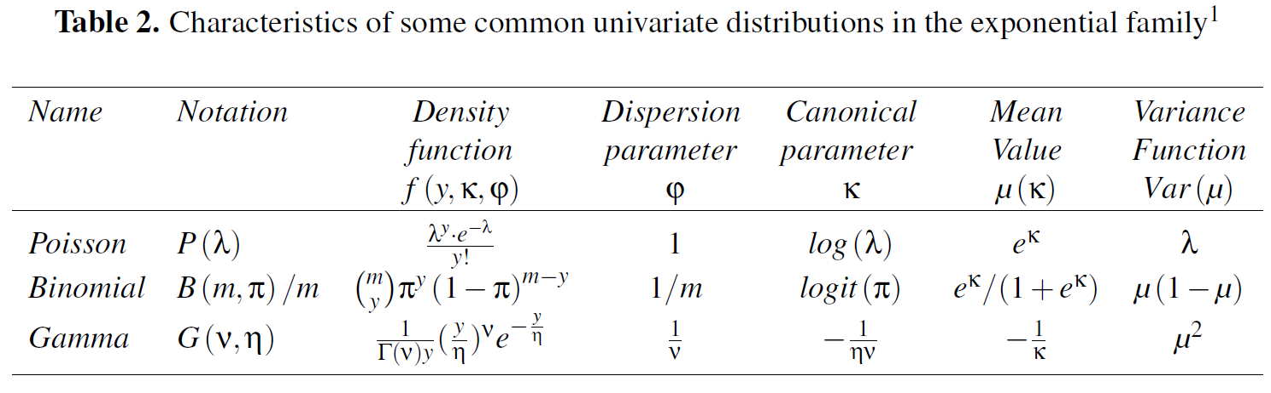
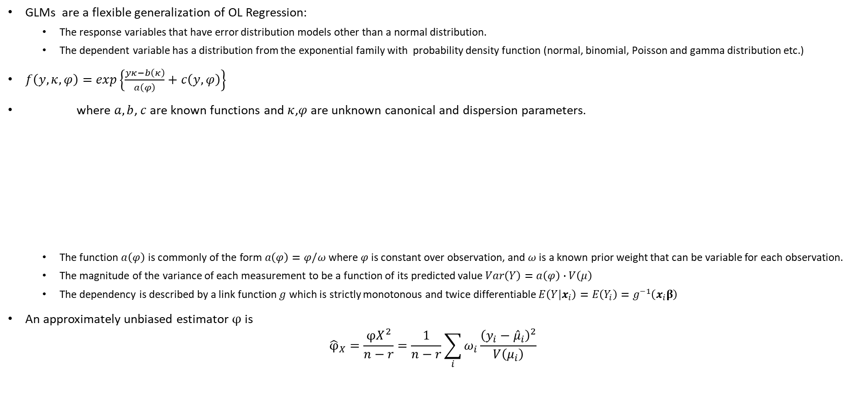

Generalized Linear Models (GLMs)
Nelder e Weddenburn,1972
GLMs are a flexible generalization of OL Regression:
  The response variables that have error distribution models other than a normal distribution.
  The dependent variable has a distribution from the exponential family with probability density function (normal, binomial, Poisson and gamma distribution etc.)
$f\left(y,κ,φ\right)=exp\left\{\frac{yκ−b\left(κ\right)}{a\left(φ\right)}+c\left(y,φ\right)\right\}$
where $a,b$, $c$ are known functions and $κ$,$φ$ are unknown canonical and dispersion parameters.
  The function $a\left(φ\right)$ is commonly of the form $a\left(φ\right)=φ/ω$ where $φ$ is constant over observation, and $ω$ is a known prior weight that can be variable for each observation.
  The magnitude of the variance of each measurement to be a function of its predicted value $Var\left(Y\right)=a\left(φ\right)∙V\left(μ\right)$
  The dependency is described by a link function $g$ which is strictly monotonous and twice differentiable $E\left(Y|x_{i}\right)=E\left(Y_{i}\right)=g^{−1}\left(x_{i}β\right)$
An approximately unbiased estimator $φ$ is
$${\hat{φ}}_{X}=\frac{{φX}^{2}}{n−r}=\frac{1}{n−r}\sum_{i}{ω_{i}\frac{{\left(y_{i}−{\hat{μ}}_{i}\right)}^{2}}{V\left(μ_{i}\right)}}$$
$$\left.\begin{matrix}N^{\left(i\right)} \\ 𝕀_{N^{\left(i\right)}} \\ {\tilde{Y}}_{i}\end{matrix}\right\}$$
The most widely adopted is the logarithm

Slide 13
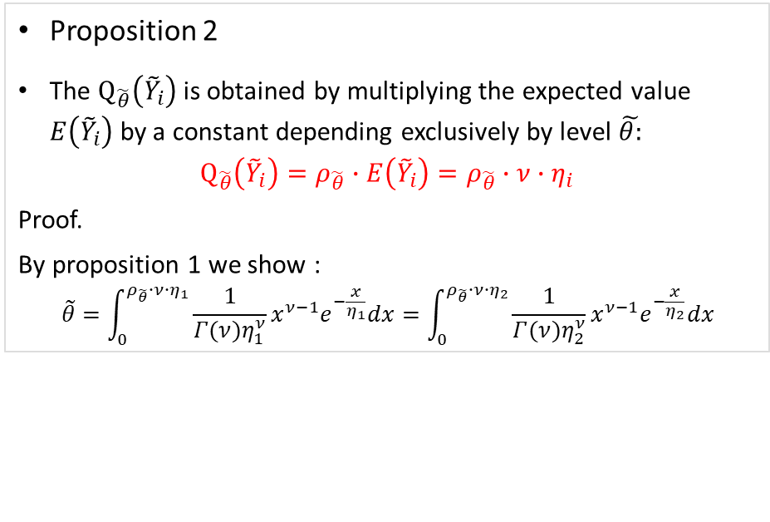
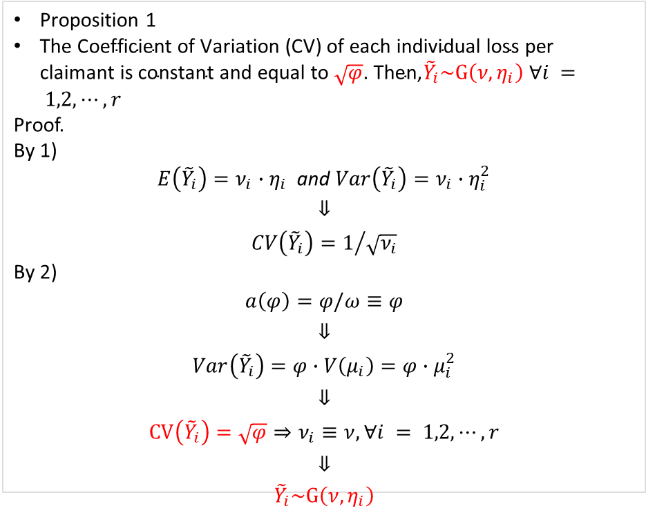
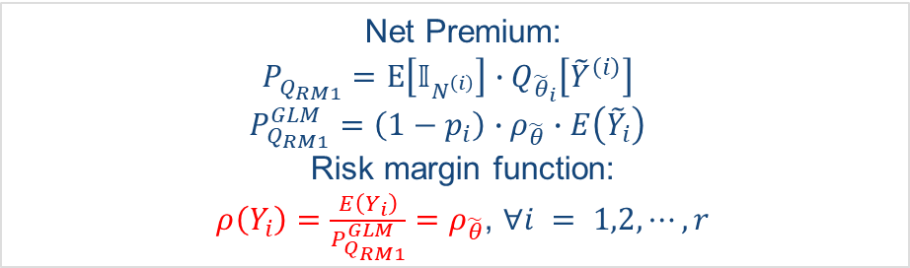
Risk margin estimation via GLMs: the case of Gamma distribution with unitary prior weights
Assuming that
  ${\tilde{Y}}_{i}\sim G\left(ν_{i},η_{i}\right)$
  prior weights $ω_{i}≡1$ for each $i = 1,2, ⋯,r$.
Proposition 1
$\text{T}\text{he} \text{Coefficient} \text{of} \text{Variation}\text{ (}\text{CV}\text{) }\text{of} \text{each} \text{individual} \text{loss} \text{per} \text{claimant} \text{is} \text{constant}$ $\text{and} \text{equal} \text{to} \sqrt{φ}\text{. }\text{Then}\text{,}{\tilde{Y}}_{i}\sim G\left(ν,η_{i}\right) ∀i = 1,2, ⋯,r$
Proof.
By 1)
${E\left({\tilde{Y}}_{i}\right)=ν}_{i}∙η_{i}$ and ${Var\left({\tilde{Y}}_{i}\right)=ν}_{i}∙η_{i}^{2}$
$$⇓$$
$${CV\left({\tilde{Y}}_{i}\right)=1}/{\sqrt{ν_{i}}}$$
By 2)
$$a\left(φ\right)=φ/ω≡φ$$
$$⇓$$
$$Var\left({\tilde{Y}}_{i}\right)=φ∙V\left(μ_{i}\right)=φ∙μ_{i}^{2}$$
$$⇓$$
$$CV\left({\tilde{Y}}_{i}\right)=\sqrt{φ}⇒ν_{i}≡ν,∀i = 1,2, ⋯,r$$
$$⇓$$
$${\tilde{Y}}_{i}\sim G\left(ν,η_{i}\right)$$
Proposition 2
The $Q_{\tilde{θ}}\left({\tilde{Y}}_{i}\right)$ is obtained by multiplying the expected value $E\left({\tilde{Y}}_{i}\right)$ by a constant depending exclusively by level $\tilde{θ:}$
  $$Q_{\tilde{θ}}\left({\tilde{Y}}_{i}\right)=ρ_{\tilde{θ}}∙E\left({\tilde{Y}}_{i}\right)=ρ_{\tilde{θ}}∙ν∙η_{i}$$
  Proof.
  By proposition 1 we show :
  $$\tilde{θ}=\int_{0}^{ρ_{\tilde{θ}}∙ν∙η_{1}}{\frac{1}{Γ(ν)η_{1}^{ν}}x^{ν−1}e^{−\frac{x}{η_{1}}}dx}=\int_{0}^{ρ_{\tilde{θ}}∙ν∙η_{2}}{\frac{1}{Γ(ν)η_{2}^{ν}}x^{ν−1}e^{−\frac{x}{η_{2}}}dx}$$
  Net Premium:
  $$P_{Q_{RM1}}^{}=E\left[𝕀_{N^{\left(i\right)}}\right]∙Q_{{\tilde{θ}}_{i}}\left[{\tilde{Y}}^{\left(i\right)}\right]$$
  $$P_{Q_{RM1}}^{GLM}={\left(1−p_{i}\right)∙ρ}_{\tilde{θ}}∙E\left({\tilde{Y}}_{i}\right)$$
  Risk margin function:
  $ρ\left(Y_{i}\right)=\frac{E\left(Y_{i}\right)}{P_{Q_{RM1}}^{GLM}}=ρ_{\tilde{θ}}$, $∀i = 1,2, ⋯,r$

Slide 14
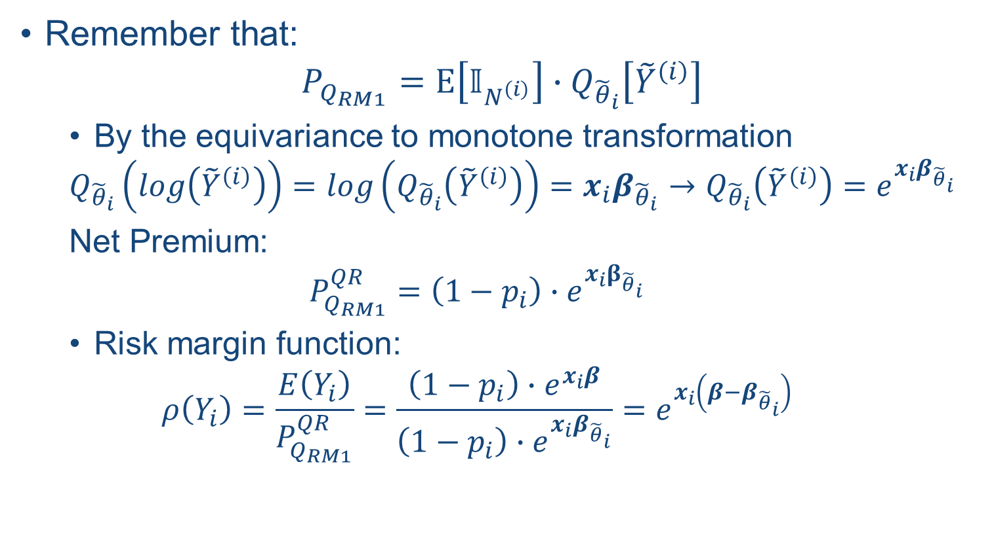
Risk margin estimation with QR
Remember that:
$$P_{Q_{RM1}}^{}=E\left[𝕀_{N^{\left(i\right)}}\right]∙Q_{{\tilde{θ}}_{i}}\left[{\tilde{Y}}^{\left(i\right)}\right]$$
  By the equivariance to monotone transformation
  $$Q_{{\tilde{θ}}_{i}}\left(log\left({\tilde{Y}}^{\left(i\right)}\right)\right)=log\left(Q_{{\tilde{θ}}_{i}}\left({\tilde{Y}}^{\left(i\right)}\right)\right)=x_{i}β_{{\tilde{θ}}_{i}}→Q_{{\tilde{θ}}_{i}}\left({\tilde{Y}}^{\left(i\right)}\right)=e^{x_{i}β_{{\tilde{θ}}_{i}}}$$
  Net Premium:
  $$P_{Q_{RM1}}^{QR}=\left(1−p_{i}\right)∙e^{x_{i}β_{{\tilde{θ}}_{i}}}$$
  Risk margin function:
  $$ρ\left(Y_{i}\right)=\frac{E\left(Y_{i}\right)}{P_{Q_{RM1}}^{QR}}=\frac{\left(1−p_{i}\right)∙e^{x_{i}β}}{\left(1−p_{i}\right)∙e^{x_{i}β_{{\tilde{θ}}_{i}}}}=e^{x_{i}\left(β−β_{{\tilde{θ}}_{i}}\right)}$$

Slide 15
Numerical Investigation
Data sets are characterized by the same total exposure and number of claimants. We consider two rating factors (e.g. sex and age-class) each one with two levels (e.g. "Male" and "Female" and "High" and "Low" respectively). Then we have four risk profiles, briefly "M-H", "F-H", "M-L" and "F-L". We assume that each risk profile has a different exposure but the same number of claimants.
The main difference between data sets is the assumptions adopted for the distribution for the total claim amount per claimants
Let:
k = 1;2;3 index the number of data set.
r = 100;000 be the number of insured/exposure

Slide 16
Numerical Investigation

Slide 17
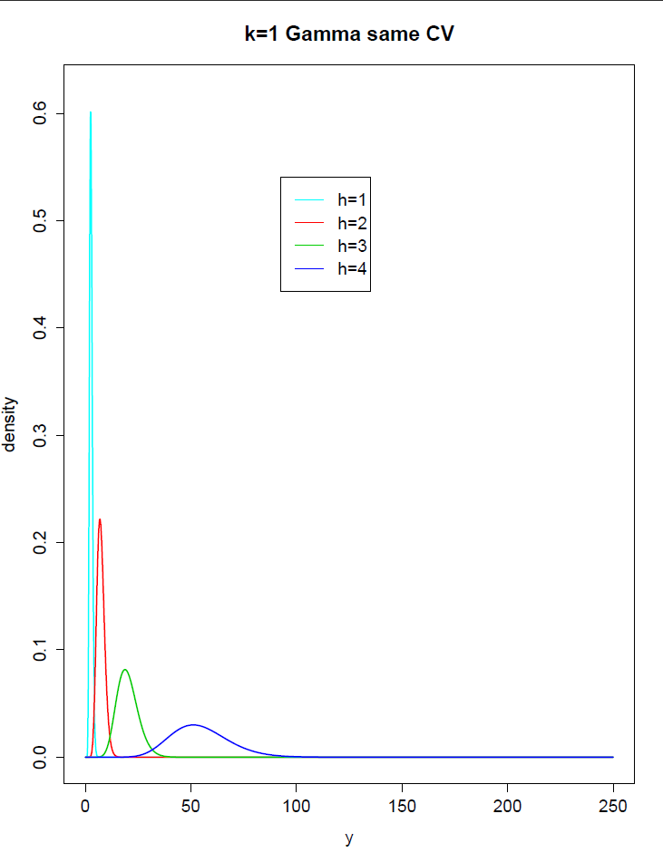
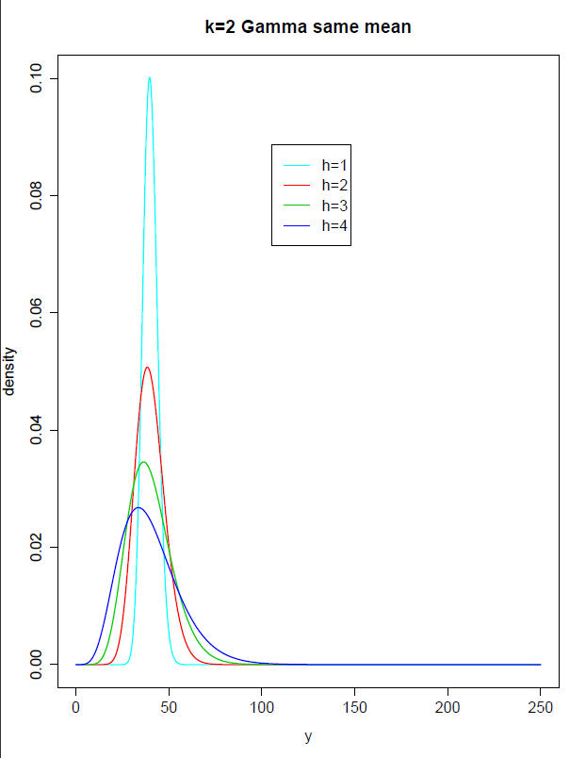
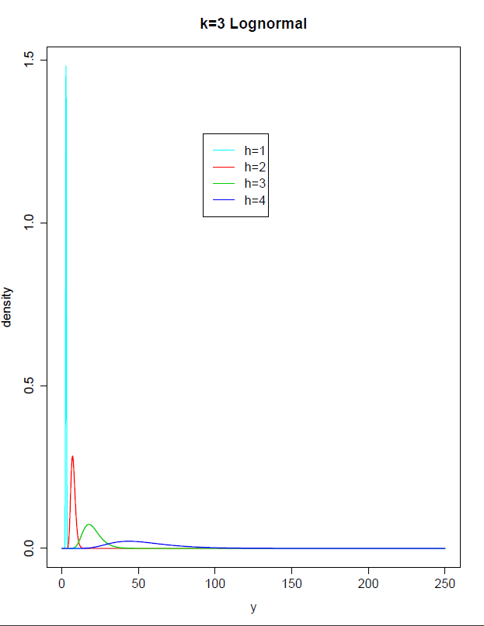
Theoretical Distributions

Slide 18
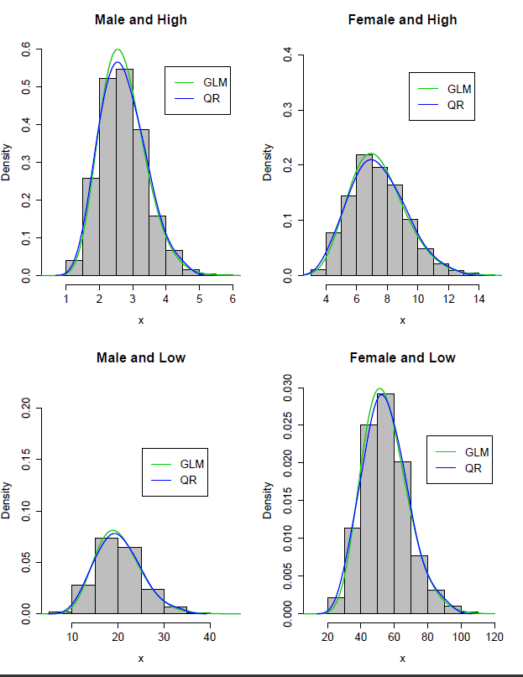
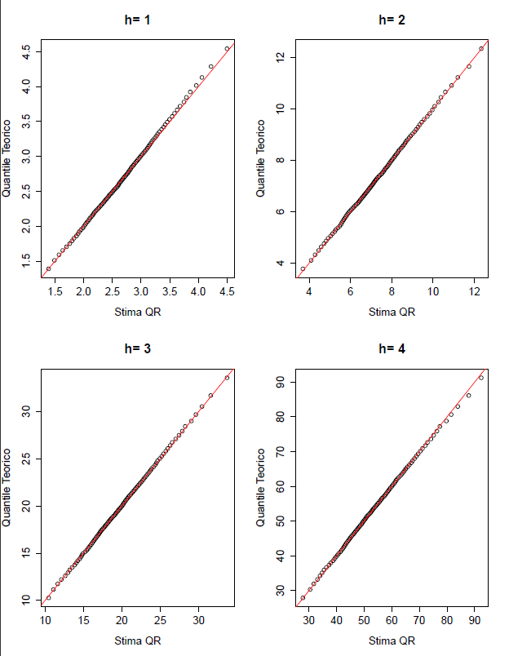
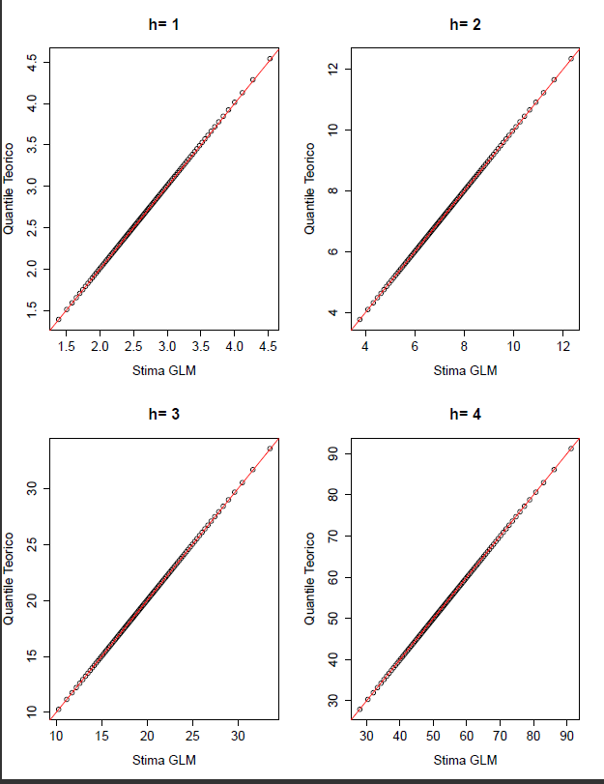
Distribution Fitting Analysis:
Gamma same CV - k=1

Slide 19
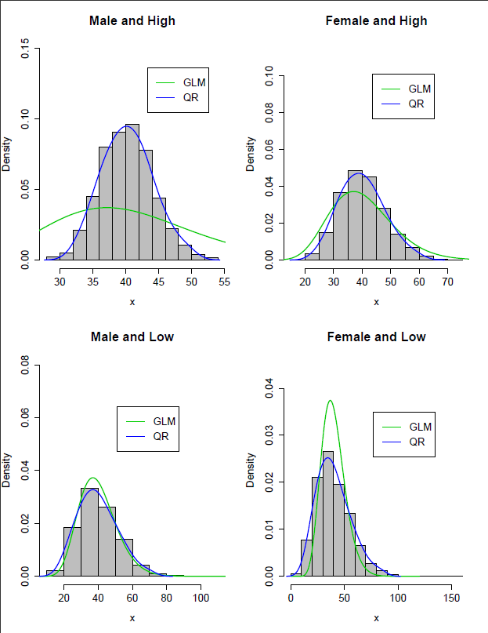
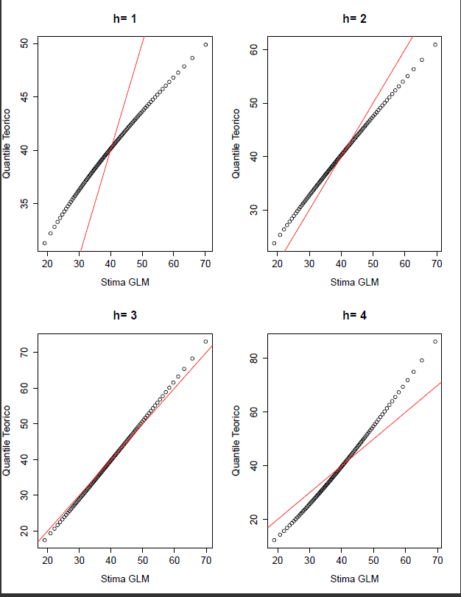
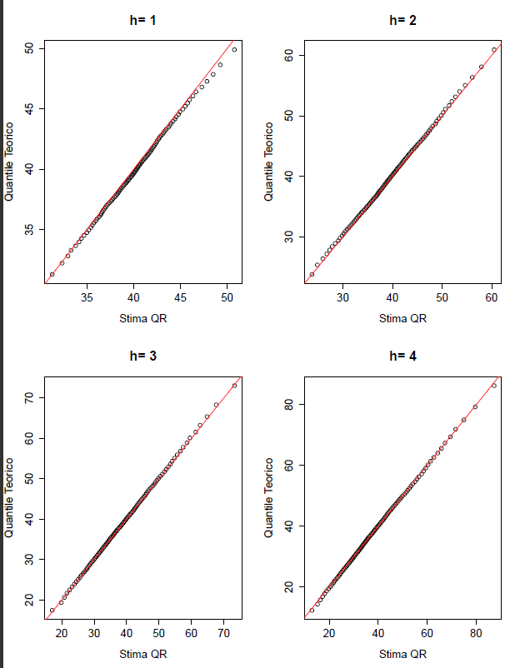
Distribution Fitting Analysis:
Gamma same Mean - k=2

Slide 20
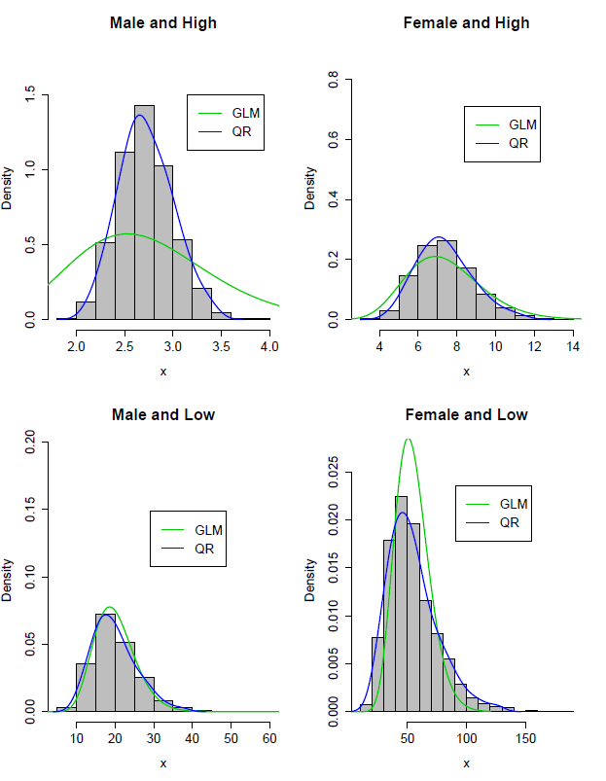
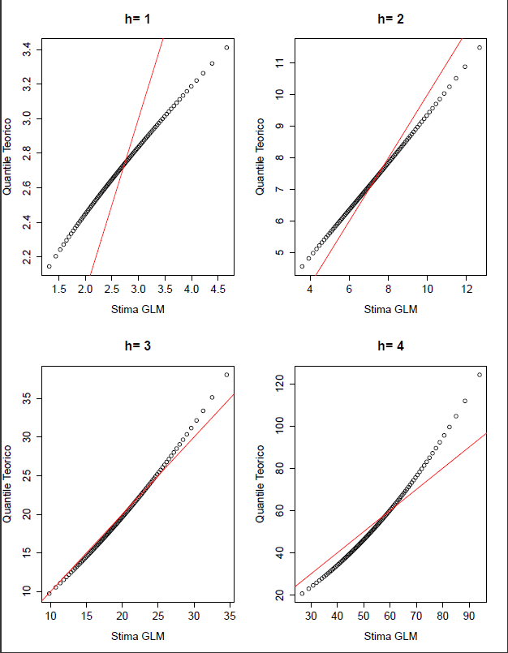
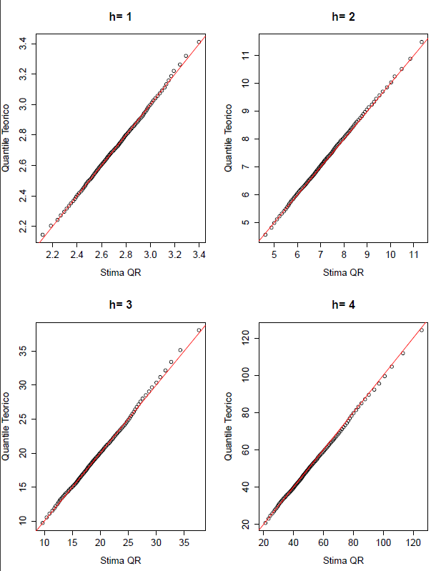
Distribution Fitting Analysis:
Lognmormal - k=3

Slide 21
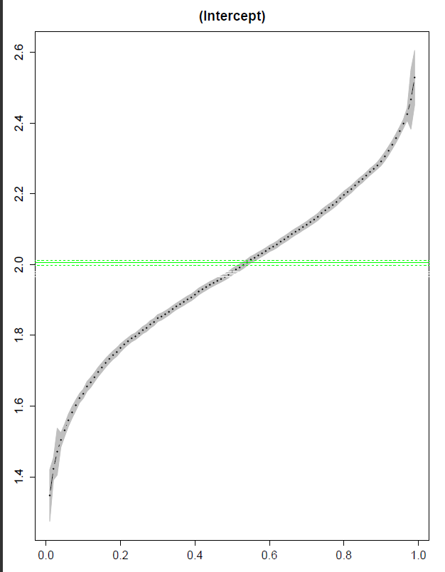
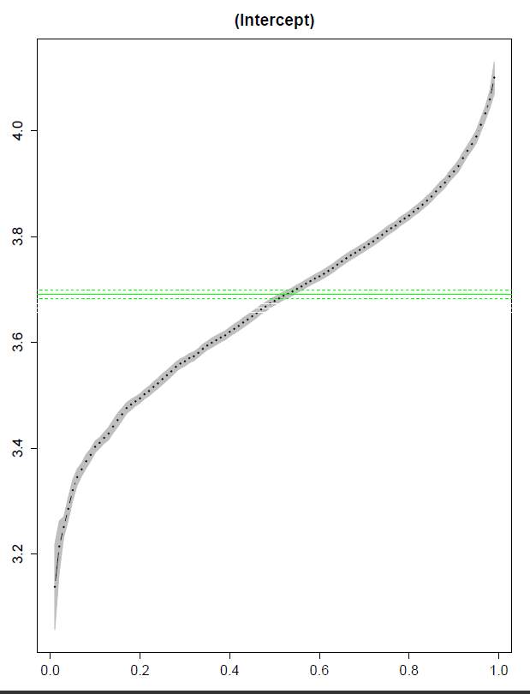
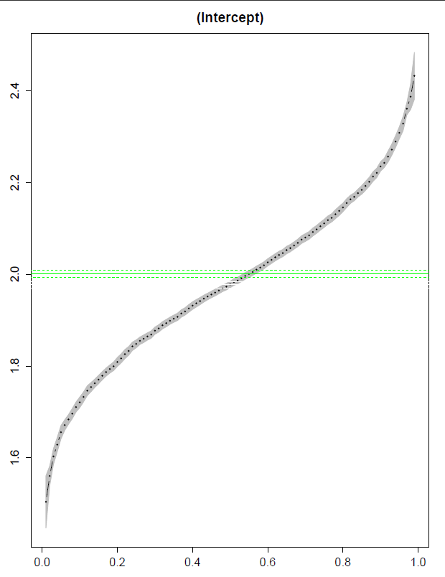
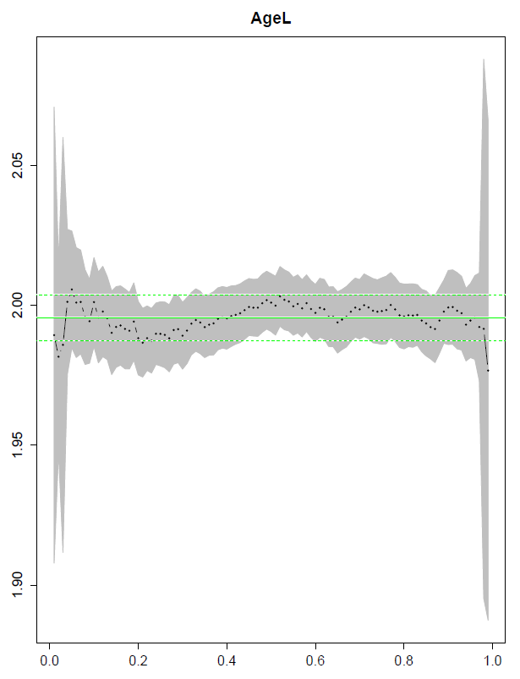
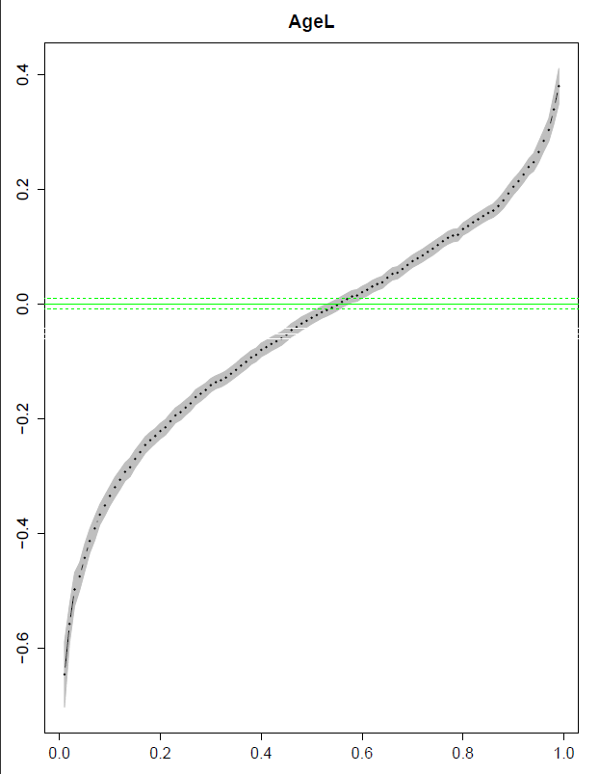
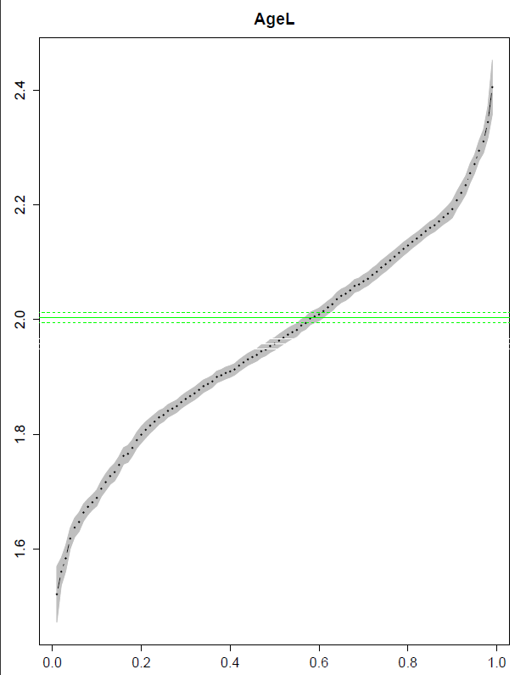
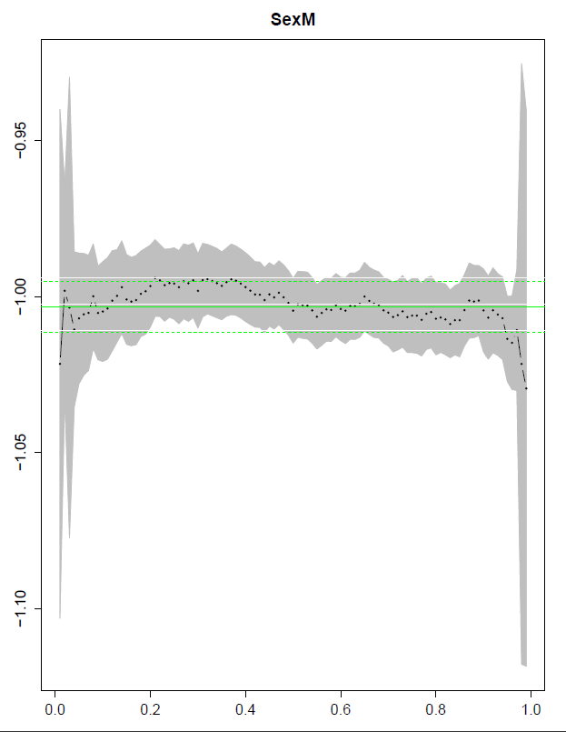
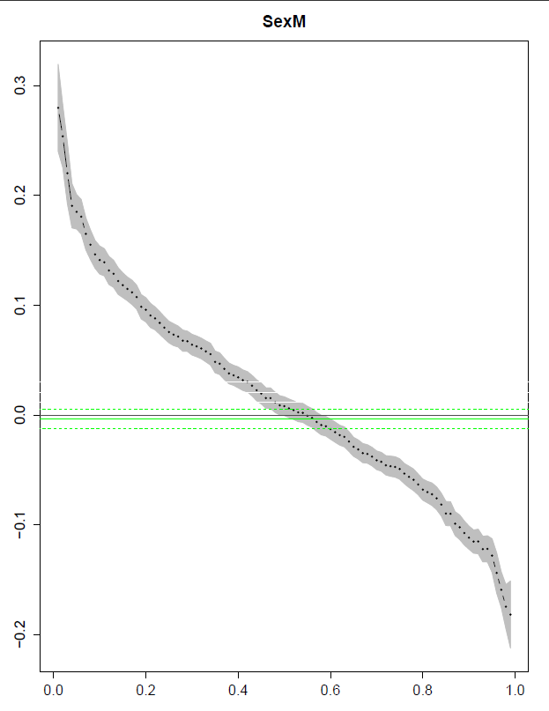
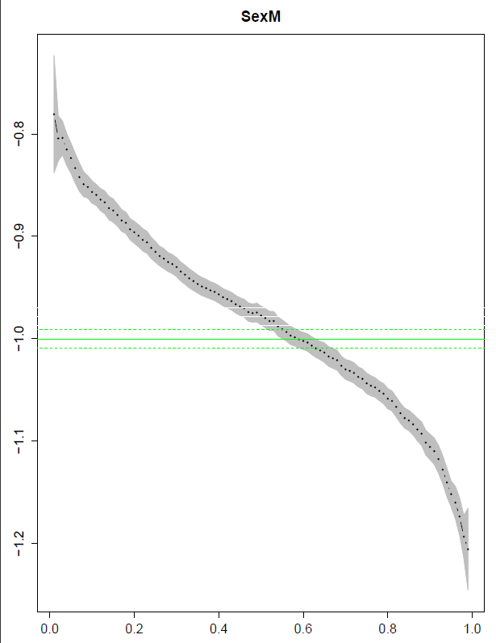
Estimated Parameter: QR vs GLMs

Slide 22
Premium Estimates
k=1 Gamma same CV
k=2 Gamma same Mean
k=3 LogN

Slide 23
Conclusions and Further research
Conclusions
  The well known drawbacks GLMs are confirmed (if necessary) by our analysis.
  The most widely adopted method used in MTPL ratemaking based on a two-part model (frequency-severity) for net premium involves a traditional expected value principle with a limited view on the variability on the risk. However it is easy to compute and to be understood.
  The solution based on a QR on the severity is more appropriate to catch the individual variability. However, the product of the mean of frequency and the quantile of the severity is not a canonical statistical measure.
  The adoption of a separate QR model for frequency and severity does not solve this issue.
Further research
  Estensione ai collective models
  Estensione a famiglia esponenziale per severity Inverse Gaussian e Tweedie
  Quantile su variabili discrete
  ALD

Slide 24
Thank you!

