Slide 1
Miles for Retirement
Saving through consumption
Fernanda Salas
AFIR-ERM Florence Colloquium
May, 2019

Slide 2
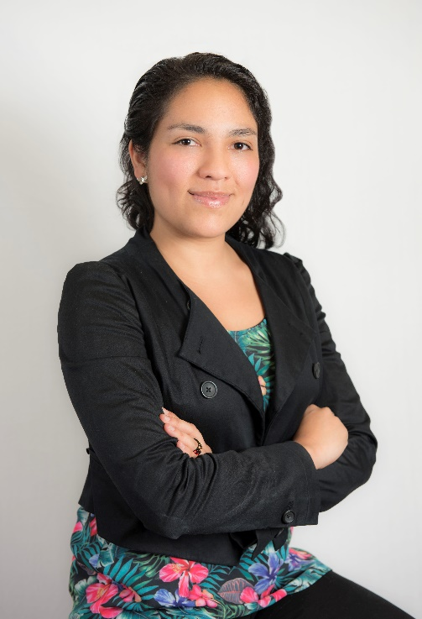

About the speaker
Fernanda Salas
Actuary, Faculty of Sciences, UNAM, Mexico
Part-time professor Finance, Risk Management and Demographics
Vice Chairwoman, AFIR-ERM Section , IAA
Member of CONAC (Mexican College of Actuaries)
Youngest member of the investments committee, VITALIS Asset Management
Actively participates in social causes getting involved in responsible investing

Slide 3
Disclaimer
The information given herein has been gathered from different sources and completed by Fernanda Salas, Vice Chairwoman of the AFIR-ERM Section of the IAA and member of the investments committee of VITALIS. The material in this presentation may include general background information about AFIR-ERM Section as well as of VITALIS current as at the date of this presentation. Such information is subject to change without notice and the IAA nor VITALIS is not under any duty to update this information nor responsible for it. The views and opinions expressed in the given presentation are those of the speaker and do not necessarily reflect the official policy or position of the IAA, the AFIR-ERM Section or VITALIS.

Slide 4

Free beer at Cancun!
GRATIFICATION
Source: Thrillist

Slide 5
Free beer at Cancun!
DELAYED
GRATIFICATION
Source: Thrillist

Slide 6
Free beer at Cancun!
Source: Thrillist
RANDOM DELAYED GRATIFICATION

Slide 7

Free beer at Cancun!
Source: Thrillist
EXPENSIVE RANDOM DELAYED GRATIFICATION
Similarities with reality are NOT purely coincidental.

Slide 8
A reality about social security
Where do we stand now?
Most of the world population has NO access to Social Security for retirement as we know it
Notwithstanding its deficiencies, is a privilege of a lucky few

Slide 9
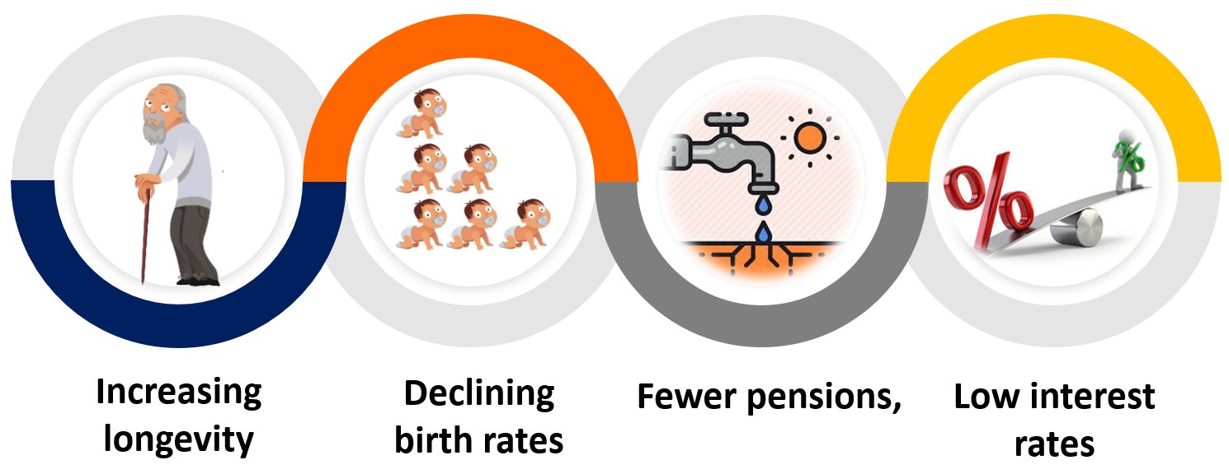
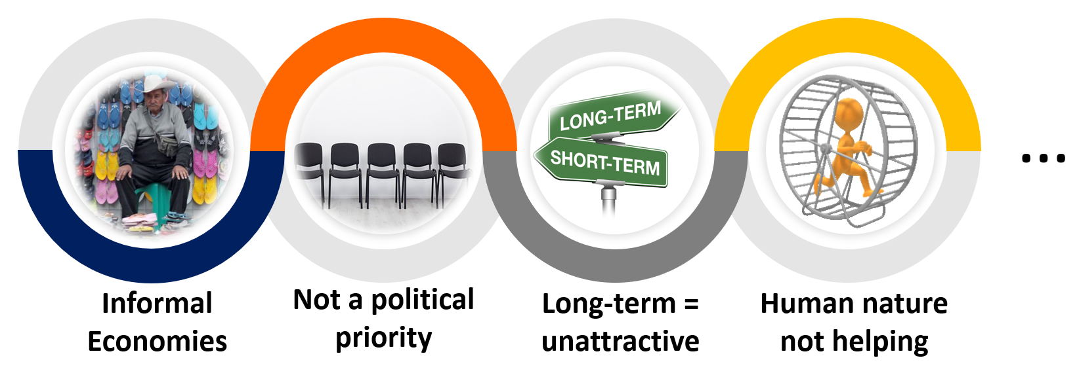
A reality about social security
Plus...
Source: Mitigating the Global Pension Crisis

Slide 10


Saving for retirement: as serious as global warming
Source: CNN
Source: express.co.uk
To ensure sufficient retirement funds for the current working generation is one of the most serious ethical, social and political challenges of our time, along with other intractable problems such as global warming.

Slide 11
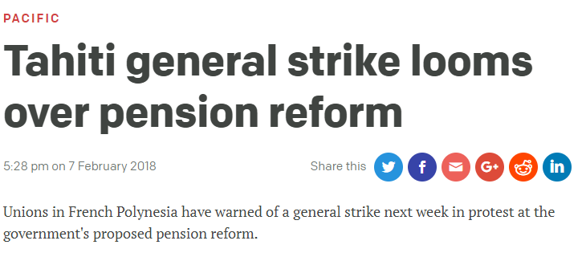
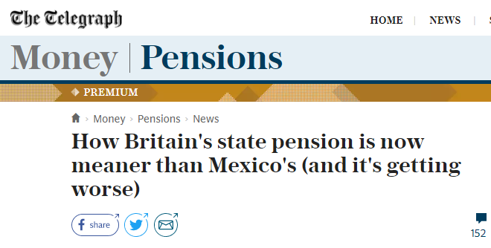
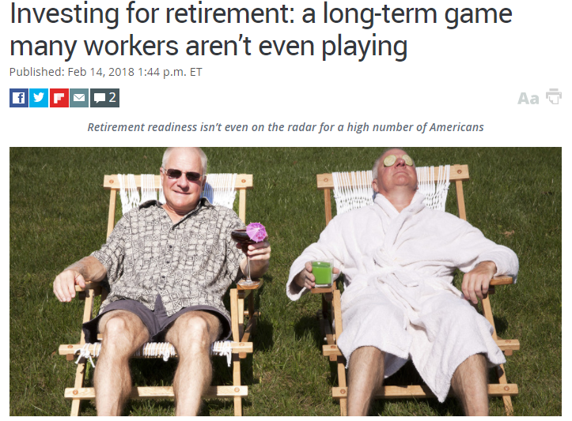
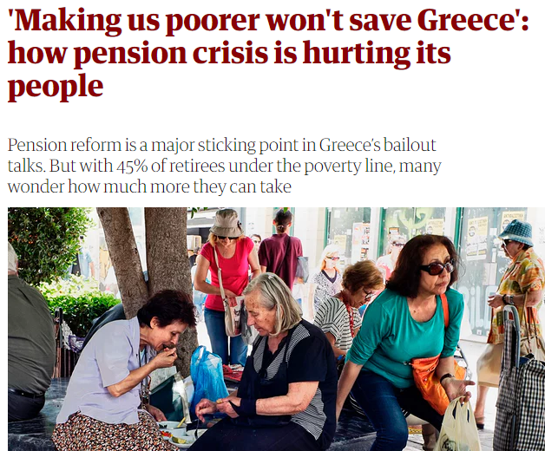
Current pension crisis
There is no “future” pension crisis, we are facing it already.
Source: The Telegraph
Source: The Guardian
Source: Marketwatch
Source: Radio New Zeland

Slide 12

A little progress in most countries via standard levers
RETIREMENT AGE
CONTRIBUTIONS
BENEFITS
INVESTMENT RETURNS
    But:
    Still woefully insufficient vs scale of crisis
    Strong public, and hence legislative, resistance
    to any changes
    We need better ideas that are easier to understand and implement
Source: nytimes

Slide 13
Looking for better returns
Diversified investment strategies:
Stocks and bonds picking + Real Estate + Private Equity + Passive investments + …
Stochastic optimal asset allocation:
Total Return and ALM (to match assets with expected future liabilities)
Ruin Probability Models
DB with better returns that DC plans (401k) due to different asset allocation (DC more conservative)
Reverse Mortgages:
Loan for homeowners (>60 years old) that allows them to convert part of their home equity into cash
Returns net of fees:
DC plans (401k) with lower net returns due to fees charges
Urges to transparency regulations such as MiFID II in Europe

Slide 14
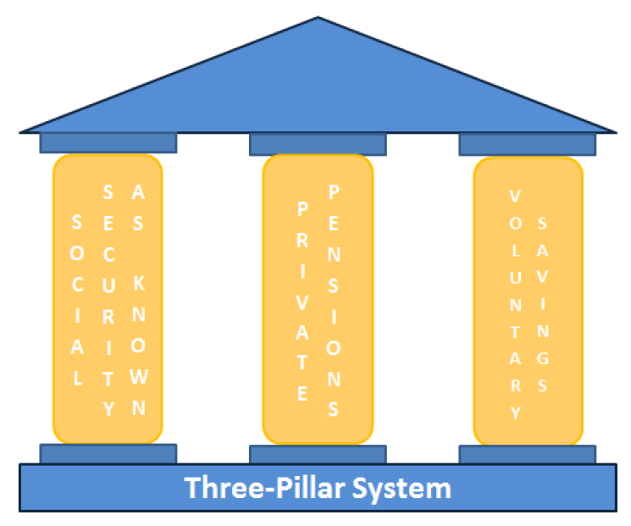
From a 3-pillar system...
SOCIAL
SECURITY AS KNOWN
PRIVATE PENSIONS
VOLUNTARY SAVINGS
Source: Own autorship

Slide 15
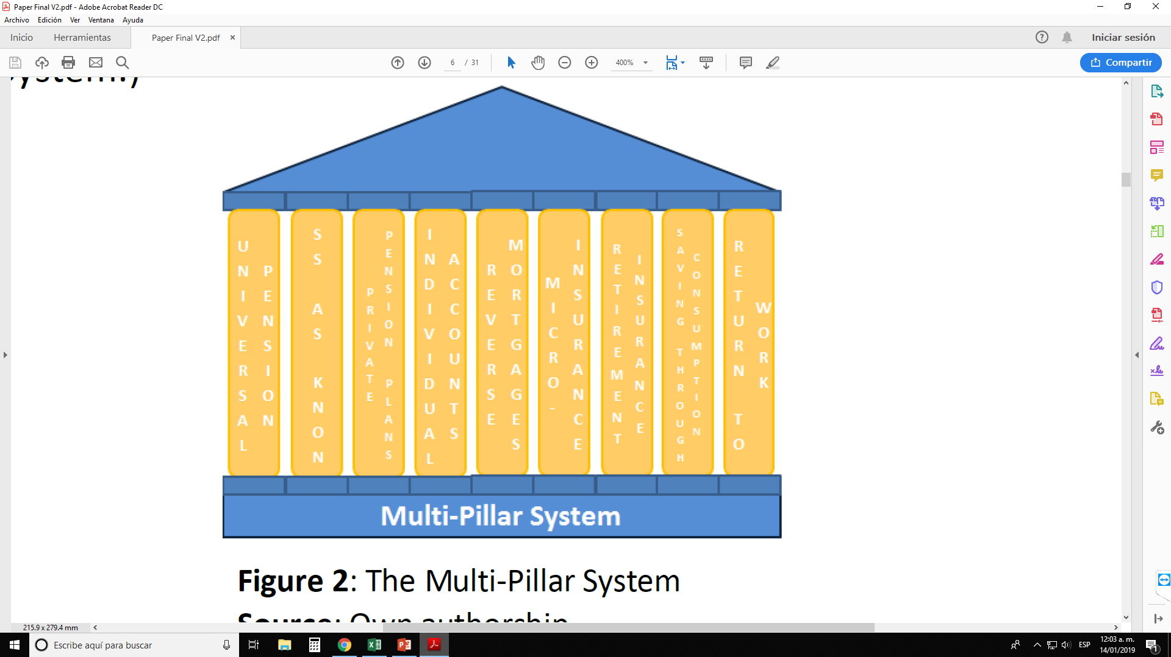
... to a multi-pillar system
UNIVERSAL PENSION
SOCIAL
SECURITY
PRIVATE PENSIONS
INDIVIDUAL SAVINGS
RETIREMENT INSURANCE
REVERSE MORTGAGES
SAVE THROUGH CONSUMPTION
MORE KIDS
CONTINUE WORKING
Source: Own autorship

Slide 16

Save as you spend
«Flip behavioural challenges into behavioural solutions» - Shlomo Benartzi (Saving for tomorrow, tomorrow)
(Miles for Retirement)

Slide 17
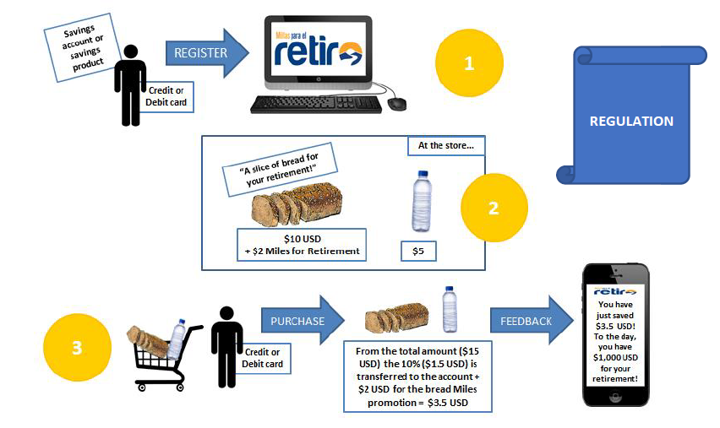

Accumulate «miles» for your retirement
Source: Own autorship

Slide 18
Special Features
It incorporates behavioural economics:
  Permanent remindings
  Short, medium and long-term rewards
  Incentive: save as you buy!
  Save through any prefered channel/product
  Creates a culture in a very easy way
Fintech
No politics or changes in regulation needed; all parties cooperating to help people save (stores, brands, insurance companies, governments, regulators, asset managers, media...)

Slide 19
Facts to date
Mexican project already implemented
Presented at the Mexican Senate (2017)
App launched in November 2018 (jointly with the Treasury and Pensions Regulator)
+20,000 downloads and +15,000 people saving already
To date, it only works linked to the Public Administrators (public pension system)
Challenge: get more saving channels, achieve a critical mass, transaction fees negotiation

Slide 20
THANK YOU!
Fernanda Salas
fsalas@vitalis.com.mx

