Slide 1
  Esame di stato: syllabus and comparison with Quantitative Finance and Insurance

Slide 2
Esame di stato: syllabus and comparison with Quantitative Finance and Insurance
The examination consists of four tests: two written tests, one practice tests and one oral test. In particular:
  The first written test concerns the probabilistic, statistic and mathematical finance tools which are applied in insurance, financial and pension sectors.
  The second written test is related to actuarial and financial mathematics techniques applied in life, non-life insurance and pension funds.
  The practice test consists in elaborating an actuarial project or in evaluating a business case which concerns actuarial themes of insurance companies and pension funds.
  The oral test relates to actuarial and mathematical finance themes applied in insurance and pension funds. The aim of this test is to assess the professional culture of the candidate, her/his synthesis and communication skills as well as her/his knowledge of the professional guidelines, legislation and code of ethics.

Slide 3
Esame di stato: syllabus and comparison with Quantitative Finance and Insurance
First written test. Subjects:
  Probability calculus
  Statistics
  Financial mathematics
  Actuarial mathematics

Slide 4
Esame di stato: syllabus and comparison with Quantitative Finance and Insurance course
Subjects | Reference Courses | Recommended books
Probability calculus | Mathematics for finance Stochastic modelling for statistical applications Stochastic processes
Statistics | Numerical and statistical methods for Finance Econometrics 2
Financial mathematics |  | Castellani, De Felice, Moriconi: Manuale di Finanza, Vol.1
Actuarial mathematics | Mathematics for insurance | E. Pitacco: Matematica e tecnica attuariale delle ass. sulla durata di vita; Modelli attuariali per le ass. sulla salute

Slide 5
Esame di stato: syllabus and comparison with Quantitative Finance and Insurance
Second written test. Subjects:
  Actuarial techniques for individual life insurance
  Actuarial techniques for non-life insurance
  Actuarial techniques for group life insurance
  Actuarial statistics
  Mathematical finance

Slide 6
Esame di stato: syllabus and comparison with Quantitative Finance and Insurance
Subjects | Reference Courses | Recommended books
Actuarial techniques for individual life insurance | Mathematics for Insurance Life insurance techniques | E. Pitacco: Matematica e tecnica attuariale delle ass. sulla durata di vita; La valutazione nelle ass. vita
Actuarial techniques for non-life insurance | Mathematics for Insurance Non- Life insurance techniques | L. Daboni: Lezioni di tecnica attuariale delle assicurazioni contro i danni
Actuarial techniques for group life insurance | Economics of Saving and Pensions | Tomassetti: Tecnica Attuariale per la collettività M.A. Coppini, M. Micocci: Tecnica delle assicurazioni sociali

Slide 7
Esame di stato: syllabus and comparison with Quantitative Finance and Insurance
Subjects | Reference courses | Recommended books
Actuarial statistics | Statistics 2
Mathematical finance | Derivatives Econofisica | J. Hull: Opzioni, futures e altri derivati

Slide 8
Esame di stato: syllabus and comparison with Quantitative Finance and Insurance
Practice test. Subjects:
  Actuarial techniques for individual life insurance
  Actuarial techniques for non-life insurance
  Actuarial techniques for group life insurance
  Management, accounting and capital requirements of insurance companies
  Evaluation of insurance portfolios

Slide 9
Esame di stato: syllabus and comparison with Quantitative Finance and Insurance
Subjects | Reference Courses | Recommended books
Management, accounting and capital requirements of insurance companies | Life and Non-Life insurance techniques Bilancio delle Assicurazioni | Direttiva Solvency ed Atti Delegati
Evaluation of insurance portfolios | Life and Non-Life insurance techniques | A. Olivieri, E. Pitacco: La valutazione nelle assicurazioni vita. Profili Attuariali.

Slide 10
Esame di stato: syllabus and comparison with Quantitative Finance and Insurance
Oral test. Subjects:
  Actuarial techniques for individual life insurance
  Actuarial techniques for non-life insurance
  Actuarial techniques for group life insurance
  Actuarial statistics
  Mathematical finance
  Management, accounting and capital requirements of insurance companies
  Evaluation of insurance portfolios
  Insurance, financial and social security legislation
  Professional legislation

Slide 11
Esame di stato: syllabus and comparison with Quantitative Finance and Insurance
Subjects | Reference Courses | Recommended books
Insurance, financial and social security legislation |  | Codice delle Assicurazioni Private A. Donati, G. Volpe Putzolu: Manuale di diritto delle assicurazioni
Professional legislation |  | Codice Deontologico e Linee Guida dell’Ordine Nazione degli Attuari.

Slide 12
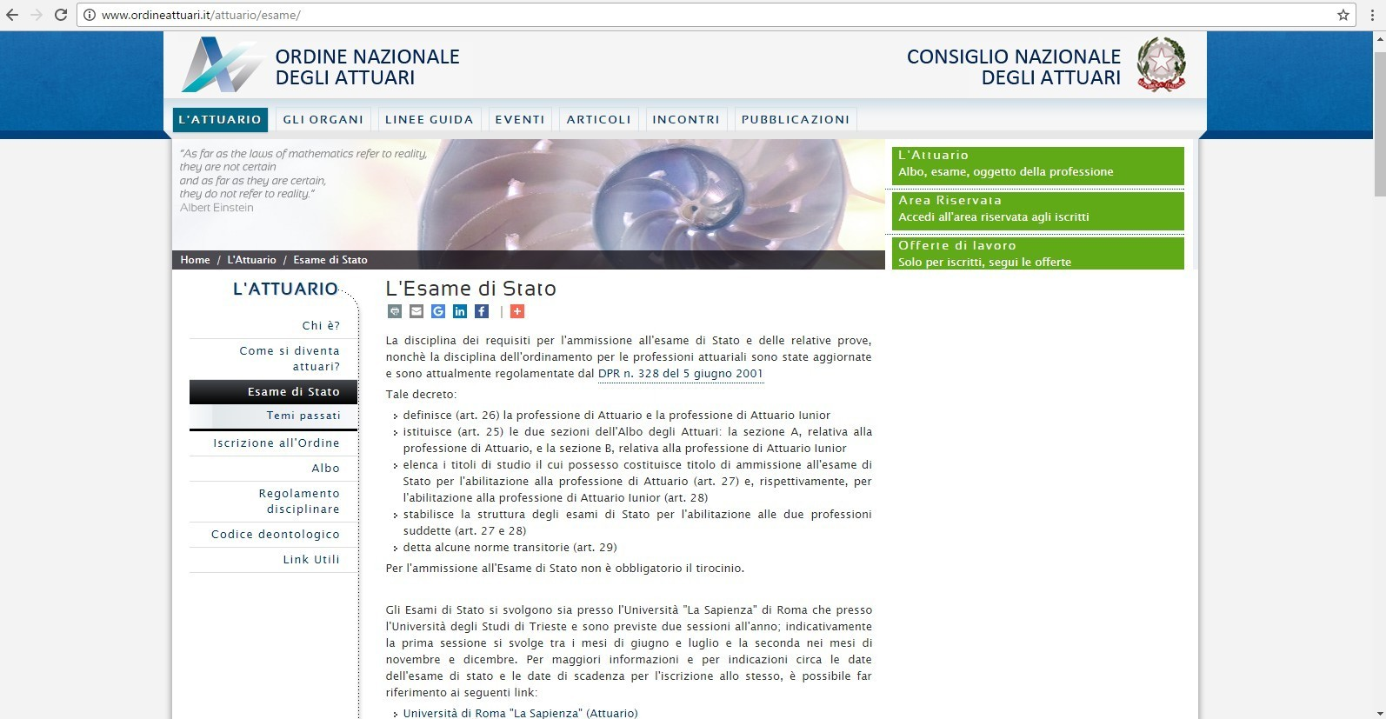
Esame di stato: syllabus and comparison with Quantitative Finance and Insurance
Where to find relevant information:
  http://www.ordineattuari.it/attuario/esame/

Slide 13
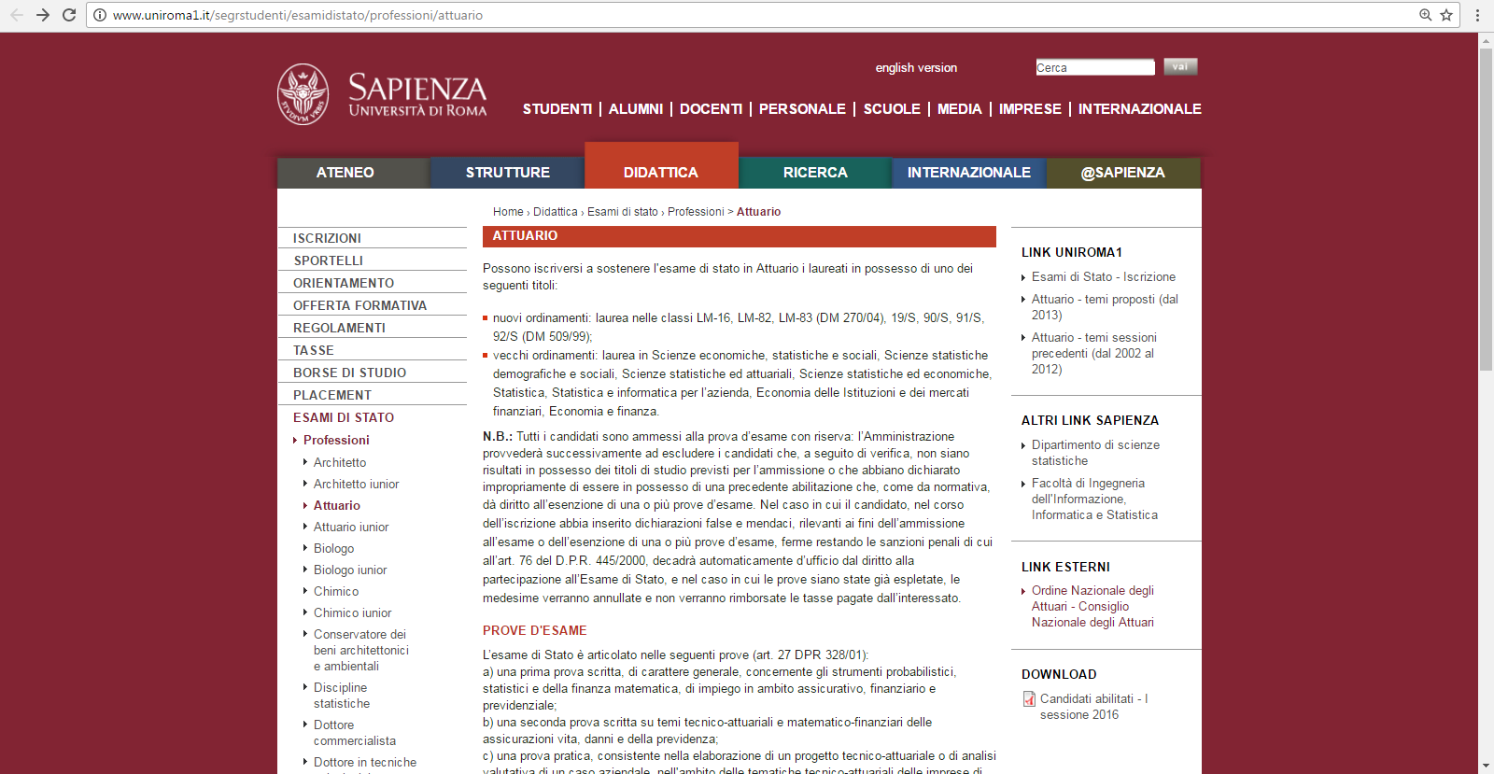
Esame di stato: syllabus and comparison with Quantitative Finance and Insurance
Where to find relevant information:
  http://www.uniroma1.it/segrstudenti/esamidistato/professioni/attuario

Slide 14
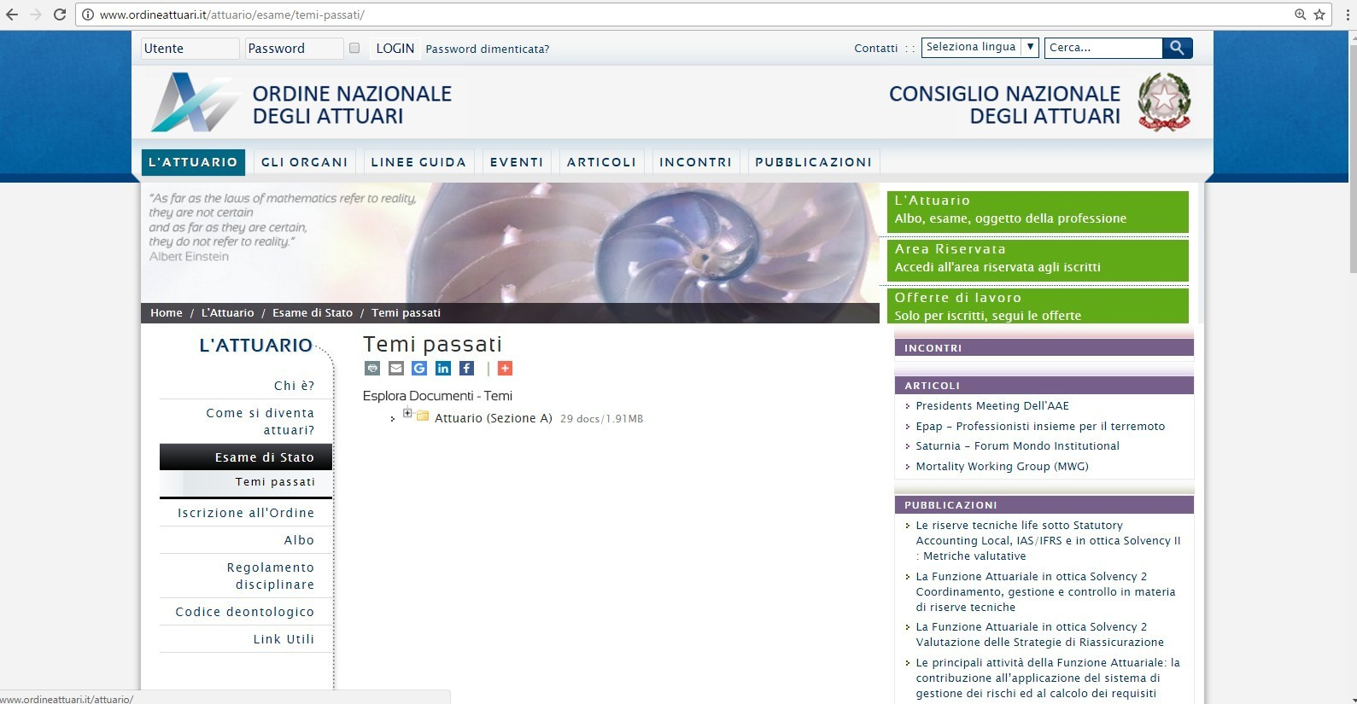
Esame di stato: syllabus and comparison with Quantitative Finance and Insurance
Where to find relevant information:
  http://www.ordineattuari.it/attuario/esame/temi-passati/

Slide 15
Esame di stato: syllabus and comparison with Quantitative Finance and Insurance
Tips:
  Exercise on past exam text.
  Specify the current job during the oral test and show prepared regarding its main aspects.
  Take the Esame di stato as soon as possible after leaving the university and having started working.
  Preparatory courses carried out by who usually organize the Esame di stato.

Slide 16

Questions?
Q
A
&

