Slide 1
Inaugural Meeting of the
Italian ASTIN Chapter
Milano, 27 Mai 2019
Frank Cuypers
ASTIN

Slide 2
What is the IAA
ASTIN founded in 1957
IACA founded in 1968
AFIR founded in 1986
…
reborn in 1998 as an
association of associations
INFLUENCE
ASSURE
ADVANCE
Lobbying, links with supranationals
Membership, education and professionalism
Foster
technical and scientific knowledge and forums
Top-down participation.
Members nominated by Associations.
Bottom-up membership.
Any actuary or insurance specialist
from industry or academia can join.

Slide 3
What is ASTIN
Focuses on General Insurance
Bridges the gap between practitioners and academics
with meaningful dialogues and research that:
  stimulate academics to explore frontiers that are relevant in practice
  catalyze the transfer of SoA techniques from academia to the industry
Creates an environment that promotes
  continuing professional development
  international exchange and collaboration

Slide 4
What is ASTIN
Focuses on General Insurance
Bridges the gap between practitioners and academics
with meaningful dialogues and research that:
  stimulate academics to explore frontiers that are relevant in practice
  catalyze the transfer of SoA techniques from academia to the industry
Creates an environment that promotes
  continuing professional development
  international exchange and collaboration

Slide 5
What does ASTIN
Colloquia
Regional meetings – Regional Chapters
Webinars – ActuView videos
Working parties
Training in countries with a developing actuarial profession
Bursaries for young actuaries & researchers from developing economies
Experts helpline (under construction)
Master classes (under construction)
Academic sabbatical facilitation (under construction)

Slide 6
What does ASTIN
Colloquia
Regional meetings – Regional Chapters
Webinars – ActuView videos
Working parties
Training in countries with a developing actuarial profession
Bursaries for young actuaries & researchers from developing economies
Experts helpline (under construction)
Master classes (under construction)
Academic sabbatical facilitation (under construction)

Slide 7
What does an ASTIN Chapter
Regional meetings (free/discounted for ASTIN members)
Window to international practice
Coordinate activities with other ASTIN Chapters and ASTIN Board
Streamline & channel ASTIN resources for
  Trainings
  Bursaries
  Webinars
  Working parties
Promote ASTIN membership

Slide 8
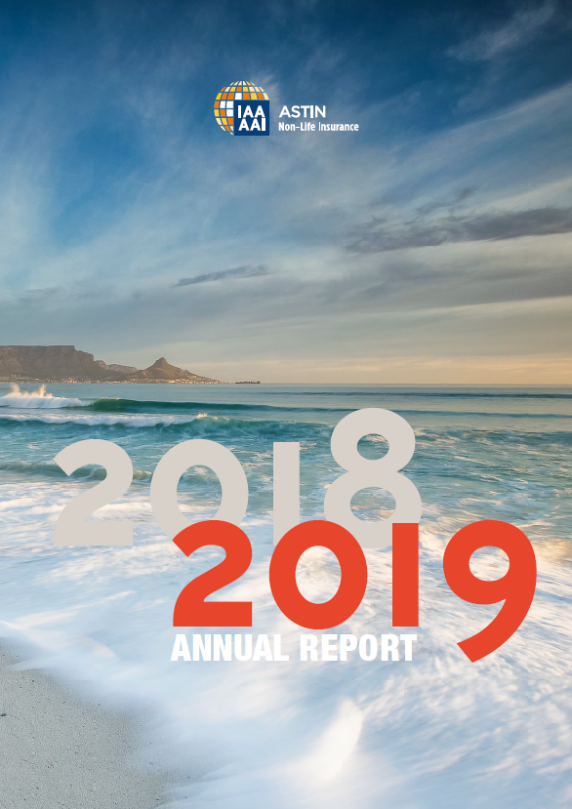
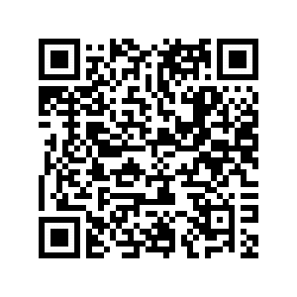
Some Added Values 2018
ASTIN Colloquium

Slide 9
Future Colloquia
2020 – Paris With all IAA Sections except Health
2021 – Orlando With AFIR
2022 – Sydney With all IAA Sections
2023 – Brussels probably ☺

Slide 10
Some Added Values 2018
ASTIN Colloquium
ASTIN Working Parties
Regional meetings
ASTIN Chapters
Webinars & videos
ASTIN Expert Helpline
ASTIN Master Classes
…

Slide 11

Some Added Values 2018
ASTIN Colloquium
ASTIN Working Parties
Regional meetings
ASTIN Chapters
Webinars & videos
ASTIN Expert Helpline
ASTIN Master Classes
…
plenty ideas
-
too little time

Slide 12
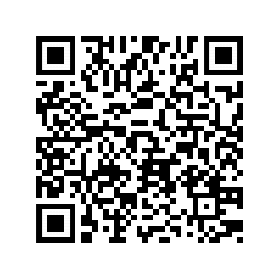
How does ASTIN work
Anybody can become member
Any member can champion a Working Party
All webinars & videos are free
Meetings are discounted
...
ASTIN members
ASTIN Board

Slide 13
How does ASTIN work
Who’s in the ASTIN Board
  Adrian Ericsson member matters
  Agnieszka Bergel annual report, ...
  Dieter Köhnlein member matters
  Eberhard Müller Treasurer, ...
  Emil Valdez Working Parties, ...
  Éric Dal Moro bursaries, ...
  Frank Cuypers wining & dining
  Kenji Shirai compliance
  Kirsten Sasady ASTIN Chapters, ...
  Michiel Van Der Wardt IAA matters, ...
  Pierre Miehe communications, ...
  Roger Hayne webinars, ...
  Yuriy Krvavych Secretary, ...

Slide 14
How does ASTIN work
ASTIN Management metastructure
Seconding the ASTIN Board
Specific task assigned
Open to any member
Board compatibility check
ASTIN members
ASTIN Management
ASTIN Board

Slide 15
How does ASTIN work
Who’s in the ASTIN Board
  Adrian Ericsson member matters
  Agnieszka Bergel annual report, ...
  Dieter Köhnlein member matters
  Eberhard Müller Treasurer, ...
  Emil Valdez Working Parties, ...
  Éric Dal Moro bursaries, ...
  Frank Cuypers wining & dining
  Kenji Shirai compliance
  Kirsten Sasady ASTIN Chapters, ...
  Michiel Van Der Wardt IAA matters, ...
  Pierre Miehe communications, ...
  Roger Hayne webinars, ...
  Yuriy Krvavych Secretary, ...
Who’s in the ASTIN Management
  Bor Harej expert helpline, ...
  Jan Dhaene scientific committees
  Salma Jamal Colloquia, ...
  Walther Neuhaus academic outreach

Slide 16
How does ASTIN work
Who‘s in the ASTIN Board
  Adrian Ericsson member matters
  Agnieszka Bergel annual report, ...
  Dieter Köhnlein member matters
  Eberhard Müller Treasurer, ...
  Emil Valdez Working Parties, ...
  Éric Dal Moro bursaries, ...
  Frank Cuypers wining & dining
  Kenji Shirai compliance
  Kirsten Sasady ASTIN Chapters, ...
  Michiel Van Der Wardt IAA matters, ...
  Pierre Miehe communications, ...
  Roger Hayne webinars, ...
  Yuriy Krvavych Secretary, ...
Who‘s in the ASTIN Management
  Bor Harej expert helpline, ...
  Jan Dhaene scientific committees
  Salma Jamal Colloquia, ...
  Walther Neuhaus academic outreach
  You !

Slide 17
Now it’s your time to act
Join and add value
to the worldwide GI community with
ASTIN
Frank Cuypers
frank.Cuypers@prs-zug.com

