Slide 1
The Actuarial Association of Europe and its Risk Management Committee
Malcolm Kemp
22 May 2019

Slide 2
Agenda
The Actuarial Association of Europe (‘AAE’)
The AAE Risk Management Committee
Examples of current RMC activities
Promoting Actuaries in Risk Management
Chief Risk Officer / Risk Management Function Holder Round Table
Actuaries and Operational Risk Management

Slide 3
Agenda
The Actuarial Association of Europe (‘AAE’)
The AAE Risk Management Committee
Examples of RMC current activities
Promoting Actuaries in Risk Management
Chief Risk Officer / Risk Management Function Holder Round Table
Actuaries and Operational Risk Management

Slide 4
About the AAE
Vision: for actuaries throughout Europe to be recognised as the leading quantitative professional advisers in financial services, risk management and social protection, contributing to the well‐being of society, and for European institutions to recognise the valuable role that the AAE plays as a leading source of advice on actuarial and related issues
Established in 1978 under the name Groupe Consultatif to represent actuarial associations in Europe
Primary purpose is to provide advice and opinions to European organisations (e.g. Commission, Council of Ministers, European Parliament, EIOPA) on actuarial issues in European legislation
36 member associations in 35 European countries, representing over 24,000 actuaries
AAE advice and comments are totally independent of industry interests

Slide 5
AAE Strategic Objectives
Strategic Objective 1: Enhance relations with European institutions
Establish and maintain relationships with key European institutions, so that the AAE can effectively provide them with high quality professional advice to improve the soundness of decisions from an actuarial perspective
Strategic Objective 2: Promote Professionalism
Promote consistent standards of education and professionalism among actuaries in Europe
Strategic Objective 3: Promote a European community of actuaries
Promote a European community of actuaries between AAE member associations, their members and the AAE

Slide 6
The AAE’s Committees
Professionalism Committee
Insurance Committee
Pensions Committee
Risk Management Committee
Education Committee
All Committees report to the AAE Board. Member Associations are allowed to send delegates to the General Assembly and representatives to events and to meetings of the AAE’s Committees

Slide 7
Agenda
The Actuarial Association of Europe (‘AAE’)
The AAE Risk Management Committee
Examples of RMC current activities
Promoting Actuaries in Risk Management
Chief Risk Officer / Risk Management Function Holder Round Table
Actuaries and Operational Risk Management

Slide 8
The AAE Risk Management Committee
Meets in person every six months (along with and sometimes in joint session with other AAE Committees), and sometimes also by conference call
Supports other AAE Committees and Working Groups
Including the AAE’s Solvency II Working Group which is currently very focused on the planned 2020 Review of Solvency II
Many different workstreams covering many topics, many likely to overlap with AFIR ERM areas of interest
All align in some way with AAE’s overall objective
Pace of progress depends on volunteer engagement
I would like to thank very much all the volunteers who contribute their valuable time to the work of the AAE RMC

Slide 9
Engages in a wide range of activities
Current and Recent Past Topics on Workplan include
2020 Review of Solvency II | Reaching out to other European risk management organisations | Promoting actuaries in risk management
Promoting consistency amongst European RM actuaries | Adding value through ORSA / ORSA support material | Actuarial Chief Risk Officer / Risk Management Function Holder Round Table
EAN on ESAP 3 (ORSA) | Risk management article database | Actuaries and operational risk
Solvency II Risk margin | Reputational and conduct risk | Remuneration policy
IFRS 17 (including risk adjustment) | Calibration of ESGs | World beyond finance and insurance risks
Systemic risk | Pension fund (IORP) risk management disciplines | Sustainable finance
IFRS 17 | Model risk | Failures and near failures of insurers

Slide 10
Agenda
The Actuarial Association of Europe (‘AAE’)
The AAE Risk Management Committee
Examples of current RMC activities
Promoting Actuaries in Risk Management
Chief Risk Officer / Risk Management Function Holder Round Table
Actuaries and Operational Risk Management

Slide 11
Promoting Actuaries in Risk Management
Internal position paper prepared, including:
Self-assessment: strengths, weaknesses, opportunities and threats?
Stakeholders’ assessment: needs and expectations of our stakeholders?
Evaluation: extent of alignment between self- and stakeholders’ assessment?
Proposed strategy: how can we best move forward?
Wide-ranging stakeholder consideration, e.g: Board of Directors, Executive Team, Regulators, Customers/Insured, Rating Agencies, Shareholders, Employers (IORPs)
Distilled for an external audience into a two-pager

Slide 12
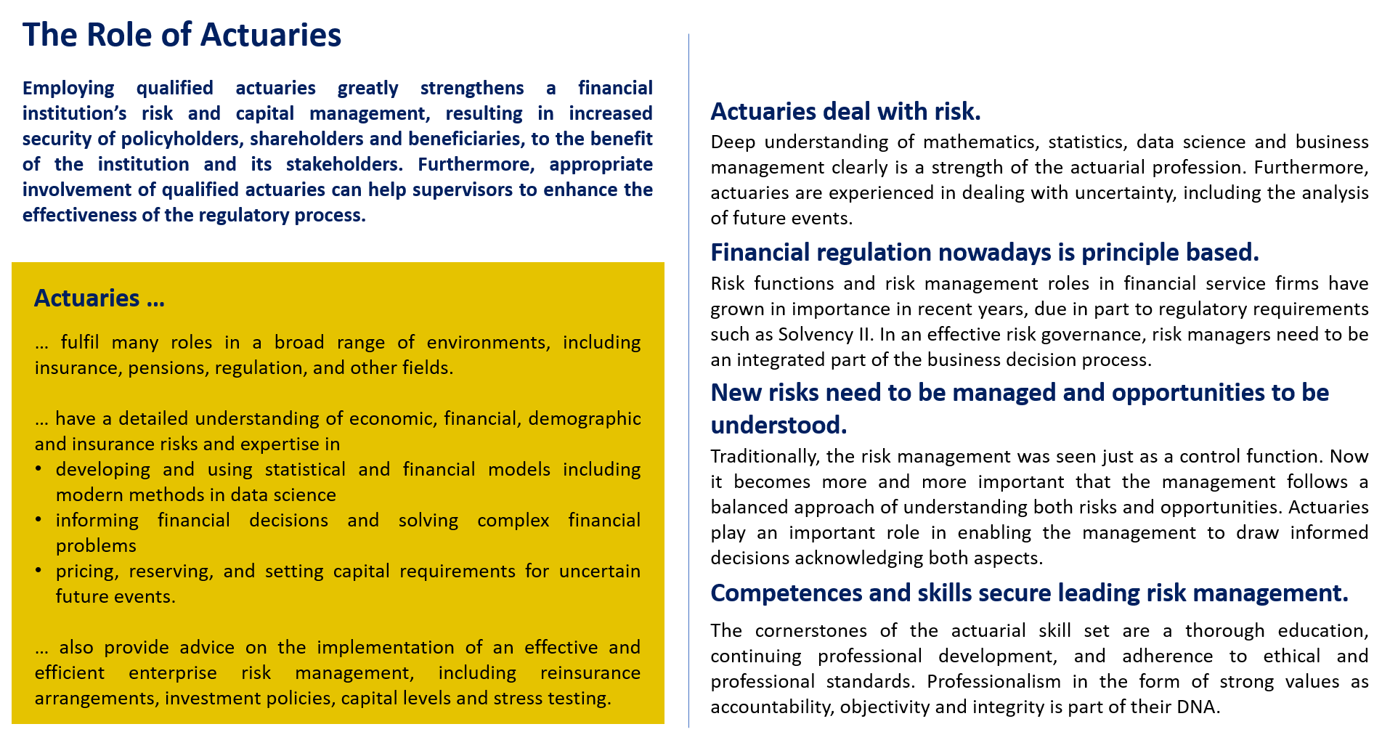
Proposed Position Paper: Promoting Actuaries in Risk Management (1)

Slide 13
Proposed Position Paper: Promoting Actuaries in Risk Management (2)

Slide 14
CRO / RMFH Round Table
Inaugural event held in Brussels in November 2018 involving c. 35 senior actuaries in insurance risk management across Europe. Topics included:
Regulatory backdrop
The relevance of systemic risk to insurance
What Boards ideally want from CROs or Heads of Risk Management Function
Panel session involving CROs discussing experiences, challenges, skills needs, how the AAE might assist and the future direction for risk management
Attendees explored added value of actuaries, promoting actuaries in risk management, skills and education needed, actuarial profession assistance for CROs etc.
Organising committee is now exploring next steps.

Slide 15
Actuaries and Operational Risk Management
Paper developed: Kemp, Krischanitz, de Level and Van den Borre (2019). “Actuaries and Operational Risk Management”. Covers:
Operational risk management disciplines, techniques and trends
Skills and techniques actuaries can bring to operational risk management
Most of paper relates to insurers or IORPs but some content broader
Appendices cover many roles that those working in operational risk are likely to get involved with
Presented to RMC in April 2019 for feedback and due to be presented externally to European Congress of Actuaries in Lisbon, June 2019

Slide 16
Main roles of an operational risk manager
Identify context: regulatory / internal / emerging risks
Coordinate overall picture: via ORSA / ORA / ICAAP / ILAAP …
Appendix A
Set the scene: workshops, gather data
Appendix B
Analyse the data and carry out modelling
Often limited data / assumptions
But typically modelling still beneficial
Appendix C
Appendix E
Understand how picture might change: stress testing, scenario analysis
Appendix D
Set/monitor limits/KRIs, iterate process
Appendix F
Communicate results and interact with others

Slide 17
E.g. Coping with limited data
Stylised split of operational risk into:
High frequency, low severity
Low frequency, high severity
Low frequency high severity now seen to dominate in financial sector
Influencing regulatory (lack of) enthusiasm for operational risk internal models, c.f. Basel III changes
Need to supplement data with expert judgement (e.g. via stress tests, workshops, …)
I.e. apply credibility theory
Akin to claims reserving, which also implicitly relies on credibility weighting if there is limited data available to estimate future development of cohort

Slide 18
Summary
The Actuarial Association of Europe (‘AAE’)
Supporting the recognition of actuaries in Europe, particularly with European institutions
The AAE Risk Management Committee
Specific committee within AAE that focuses on risk management
Broad remit, given wide ranging nature of risk management
Examples of current RMC activities
Many, ones given focused on:
Promoting Actuaries in Risk Management
Chief Risk Officer / Risk Management Function Holder Round Table
Actuaries and Operational Risk Management

