Slide 1
Opportunities for actuaries in banking
Iain Allan
May 2019

Slide 2
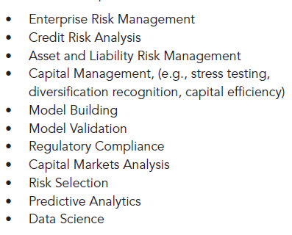
Opportunities for actuaries in banking
Banking Seminar, Washington, 14 May 2019

Slide 3
Opportunities for actuaries in banking
Experience in banking
Quantification of capital requirements and buffers
Retail banking product pricing and profitability

Slide 4
Iain Allan – Movement into banking
1969-74 | Scottish Life | Fund management
1974-79 | UK Provident | Fund management
1979-85 | Phillips & Drew* | Stockbroking
1985-91 | UBS | Investment banking
*In 1985, Phillips & Drew was acquired by UBS

Slide 5
Iain Allan – Experience in banking
1994-2008 Group Director, Strategy, RBS
Supermarket banking joint venture with Tesco
Acquisition of NatWest
Strategic partnership with Bank of China

Slide 6
Iain Allan – Experience in banking
2008-2019 Independent consultant
Applications for banking licences by new entrants
Regulatory submissions by smaller banks
Draft responses to regulatory consultations

Slide 7
Opportunities for actuaries in banking
Quantification of capital requirements and buffers

Slide 8
Insurance companies – Solvency II
Three pillars
Pillar 1: Quantification of capital requirements
Pillar 2: Supervisory review process
Pillar 3: Requirements for public disclosures
Regulatory submission
Own Risk and Solvency Assessment (ORSA)

Slide 9
Banks – Basel regulations
Three pillars
Pillar 1: Quantification of capital requirements
Quantification of liquidity requirements
Pillar 2: Supervisory review process
Pillar 3: Requirements for public disclosures
Regulatory submissions
Internal Capital Adequacy Assessment Process (ICAAP)
Internal Liquidity Adequacy Assessment Process (ILAAP)

Slide 10
Banks – Quantification is fragmented
Pillar 1 Minimum capital requirements
(Basel regulations)
Pillar 2A Additional capital requirements
(proposed by bank, set by PRA)
Pillar 2B Capital buffers
(Minimum – Basel regulations/CRR)
Additional – proposed by bank, set by PRA)

Slide 11
Pillar 1 – Minimum capital requirements
Basel regulations/CRR* prescribe methodologies for quantifying credit, market and operational risk
*CRR: Capital Requirements Regulations

Slide 12
Pillar 1 – Minimum capital requirements
Basel regulations/CRR prescribe methodologies for quantifying credit, market and operational risk
Banks can use either standardised approach (SA) or internal risk-based (IRB) approach (internal models)

Slide 13
Pillar 1 – Minimum capital requirements
Basel regulations/CRR prescribe methodologies for quantifying credit, market and operational risk
Banks can use either standardised approach (SA) or internal risk-based (IRB) approach (internal models)
Banks must quantify RWAs for credit risk and equivalent RWAs for market and operational risk

Slide 14
Pillar 1 – Minimum capital requirements
Risk weight | SA | IRB (average)
Mortgages
LTV under 50% | 35.0% | 4.5%
LTV 70% - 80% | 35.0% | 13.9%
Credit cards
UK | 75.0% | 79.6%
International | 75.0% | 112.6%
Corporates
Large corporates |  | 46.3%
Mid corporates |  | 71.6%
SME |  | 59.8%

Slide 15
Pillar 1 – Minimum capital requirements
Basel regulations/CRR prescribe methodologies for quantifying credit, market and operational risk
Banks can use either standardised approach (SA) or internal risk-based (IRB) approach (internal models)
Banks must quantify RWAs for credit risk and equivalent RWAs for market and operational risk
Minimum capital requirements are defined as percentages of total RWAs

Slide 16
Pillar 1 – Minimum capital requirements
Capital | % total RWAs
Total | 8%
Common Equity Tier 1 (CET1) | At least 4.5%
Additional Tier 1 (AT1) | Up to 1.5%
Tier 2 (T2) | Up to 2%

Slide 17
Pillar 2A – Additional capital requirements
Areas not captured under Pillar 1
Credit concentration risk
Counterparty credit risk
Interest rate risk in the banking book (IRRBB)
Pension obligation risk
In the UK, the PRA has given guidance on methodologies that may be used

Slide 18
Pillar 2A – Additional capital requirements
Areas that may not be adequately captured under Pillar 1, if using standardised approach
Credit risk
Market risk
Operational risk
In the UK, the PRA has given guidance on methodologies that may be used

Slide 19
Pillar 2B – Capital buffers
Buffer | % total RWAs | Set by
Buffers set for all banks
Capital conservation buffer | 2.5% | Basel
Countercyclical capital buffer | Up to 2.5% | BoE
Buffers set for individual banks
Systemic risk buffer | Up to 3% | BoE
PRA buffer | n/a | PRA

Slide 20
Pillar 2B – Capital buffers
PRA buffer ensures that bank does not breach its minimum capital requirements, even under severe stress scenarios:
System-wide stress scenarios
Bank-specific stress scenarios
Combined stress scenarios
Bank must also carry out reverse stress test

Slide 21
Pillar 2B – Capital buffers
No PRA buffer
PRA buffer
% total RWAs
ST: Buffer determined by stress testing; Basel: Buffer set by Basel regulations

Slide 22
Quantification of capital requirements and capital buffers
Why actuaries?
Pillar | Requirement
Pillar 1 | Compliance with regulations
Pillar 2A | Understanding and judgement
Pillar 2B | Understanding and judgement

Slide 23
Quantification of capital requirements and capital buffers
Why actuaries?
In the run up to the financial crisis, financial supervision relied too much on ‘tick-box’ compliance with rules and directives at the expense of proper in-depth and strategic analysis. Effective prudential regulation of firms requires an approach based on understanding of their business models and the ability to make judgements about the risks that their firms activities pose to themselves and to the wider financial system as a whole.
HM Treasury

Slide 24
Quantification of capital requirements and capital buffers
Why actuaries?
Some banks have announced their intention to meet the required 9% target ratio through so called ‘RWA optimisation’ – changes in risk measurement methodology the lead to reduction in reported RWAs. Such changes may not result in any improvements in underlying resilience.
Bank of England

Slide 25
Quantification of capital requirements and capital buffers
Why actuaries?
Actuaries are trained to understand risks and to make judgements about them
Actuaries are used to working under professional standards
(Code, CPD/PST, Standards)
ICAAP covers all areas of business and all types of risk
(Enterprise Risk Management)

Slide 26
Quantification of capital requirements and capital buffers
Why actuaries now?
IFR39 versus IAS39, from 1 January 2018
IAS39 (incurred loss accounting);
Make provisions in event of risk events occurring
IFRS9 (expected loss accounting):
Make provision for all loans, in three stages:
Stage 1: Performing loans: 12 months expected losses
Stage 2: Underperforming loans: Lifetime expected losses
Stage 3: Non-performing loans: Lifetime expected losses

Slide 27
Quantification of capital requirements and capital buffers
Why actuaries now?
IFRS9 (expected losses) versus IAS39 (incurred losses)
Base case
Lower capital resources (after loss provision)
May also be lower capital requirements
Stress scenario
Expected losses rise rapidly
Capital position deteriorates more, and more quickly

Slide 28
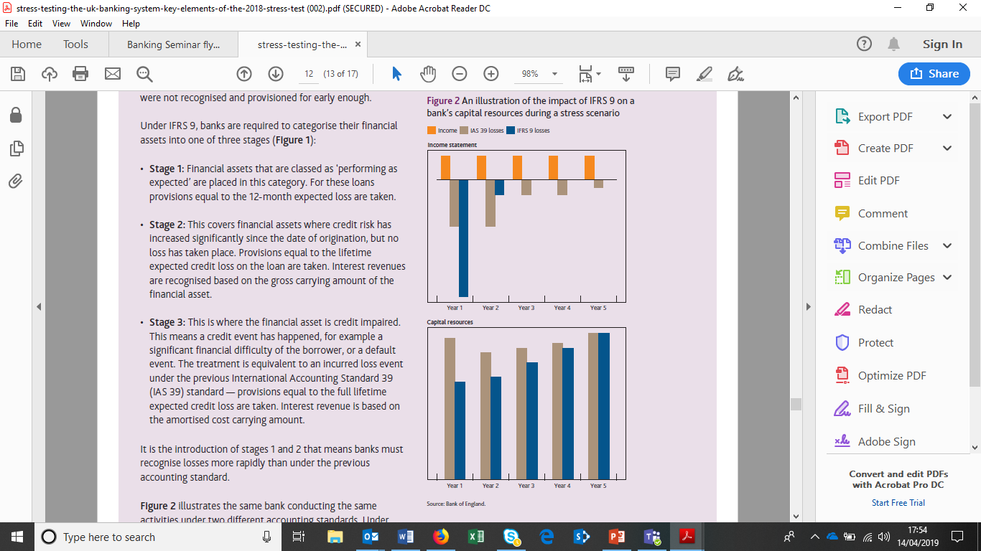

IFRS9 versus IAS39

Slide 29
Quantification of capital requirements and capital buffers
Why actuaries now?
Banks need to estimate expected losses under base case conditions and under stress scenarios
Banks need to make judgements about buffers in light of IFRS9 versus IAS39 stress tests

Slide 30
Opportunities for actuaries in banking
Retail banking product pricing and profitability

Slide 31
Product pricing and profitability
Products
Current accounts
Deposit accounts
Mortgages
Credit cards
Personal loans

Slide 32
Product pricing and profitability
Cash flows for financial model
Income | May be fixed or variable
Costs | May be direct or shared
Credit losses | Need to allow for IFRS9
Capital | P1/P2A product-specific, P2B shared
Liquidity | Balance sheet limits liquidity risk

Slide 33
Product pricing and profitability
Why actuaries?
Need for understanding and judgement
Not rely on deterministic model, base case

Slide 34
Product pricing and profitability
Why actuaries?
The Bank recognises that all models are simplifications of reality, with both known and – perhaps more importantly – unknown weaknesses. The results of models are therefore a baseline against which judgement should be applied and are not ‘the answer’.
Bank of England

Slide 35
Product pricing and profitability
Need for understanding and judgement
Balance sheet: Maturities of loans, deposits
Mortgages: Behavioural shorter than contractual
Current accounts: Behavioural longer than contractual
Income: Some items depend on customer behaviour
Interest income: Expected retention rates
Non-interest income: Fees on current accounts

Slide 36
Product pricing and profitability
Need for understanding and judgement
Costs: Shared costs include IT, Treasury, distribution
Allocate shared costs across products
May evaluate with/without shared costs
Funding costs: regard deposits as profit centre
Treasury sets funds transfer pricing rates
Rates include term liquidity premium

Slide 37
Product pricing and profitability
Need for understanding and judgement
Credit losses: Allow for IFRS9
Initial capital for provisions as well as for loans
IFRS9 impairments in profit and loss account
Capital: Allow for total capital supporting product
Pillar1/Pillar2A capital is product-specific
Allocate Pillar 2B buffers, allowing for relative risk

Slide 38
Product pricing and profitability
Need for understanding and judgement
Discount rate for NPV, hurdle rate for IRR
Prefer cost of equity capital, but could use weighted average cost of capital
Use CAPM for each bank
Apply same discount/hurdle rate to all products
Differentiation by risk already achieved through amount of capital (including buffers) supporting product

Slide 39
Product pricing and profitability
Not rely on deterministic model, base case
NPV/IRR model is convenient and straightforward
Evaluate sensitivities as well as base case
If possible, use an approach that allows for a range of possible outcomes

Slide 40
Product pricing and profitability
Why actuaries now?
PSD2 (Open Banking in UK) has potential to transform retail banking
Customers may authorise transfer of data to approved third parties:
Price comparison websites for individuals
Information and advice for individuals
Personal financial management services
Other innovative banking services

Slide 41
Product pricing and profitability
Why actuaries now?
Product pricing and profitability
New entrants seek profitable product/customers
Incumbents need to defend market shares/profits
Likely shift from product focus to customer focus
Use data to evaluate customer relationships
Use data to enhance customer relationships

Slide 42
Opportunities for actuaries in banking
Build on existing skills and experience in equivalent activities in insurance and pensions
Make effective contribution because of training in understanding risks and in making judgements about them and because of their experience of working under professional standards
Opportunities to engage in enterprise risk management and to apply data science techniques

Slide 43
Opportunities for actuaries in banking
Iain Allan
Iain.allan1965@gmail.com

