Slide 1
A Megatrend-ESG
long-term investing approach
Fernanda Salas
AFIR-ERM Florence Colloquium May, 2019

Slide 2
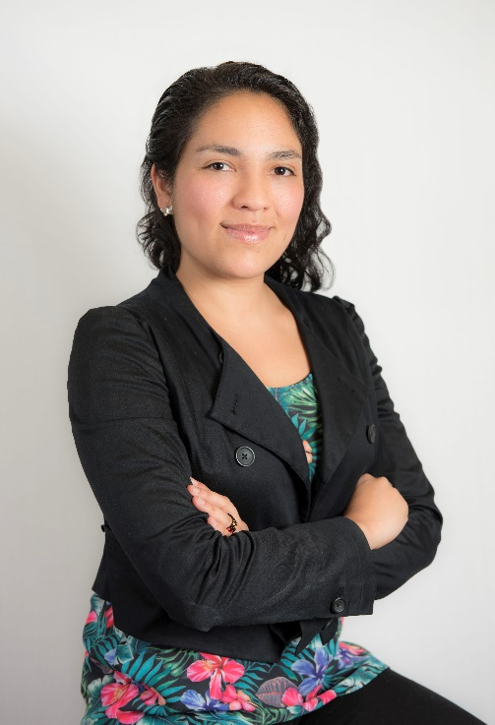
About the speaker
Fernanda Salas
Actuary, Faculty of Sciences, UNAM, Mexico
Part-time professor Finance, Risk Management and Demographics
Vice Chairwoman, AFIR-ERM Section , IAA
Member of CONAC (Mexican College of Actuaries)
Youngest member of the investments committee, VITALIS Asset Management
Actively participates in social causes getting involved in responsible investing

Slide 3
Disclaimer
The information given herein has been gathered from different sources and completed by Fernanda Salas, Vice Chairwoman of the AFIR-ERM Section of the IAA and member of the investments committee of VITALIS. The material in this presentation may include general background information about AFIR-ERM Section as well as of VITALIS current as at the date of this presentation. Such information is subject to change without notice and the IAA nor VITALIS is not under any duty to update this information nor responsible for it. The views and opinions expressed in the given presentation are those of the speaker and do not necessarily reflect the official policy or position of the IAA, the AFIR-ERM Section or VITALIS.

Slide 4
Content
MT
Why invest in Megatrends?
Defining the Megatrends
UN Sustainable Development Goals
UN PRI
Why ESG matters? “Doing great by doing good”
Megatrends + ESG complementing each other

Slide 5
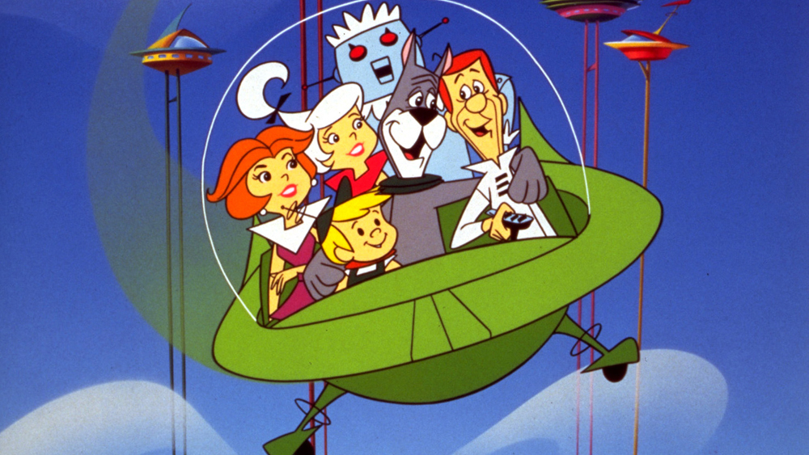
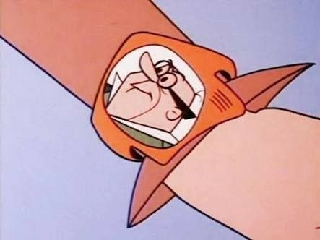
Introduction
THE JETSONS (I pronipoti)
Source: Wikipedia
Source: Pinterest

Slide 6
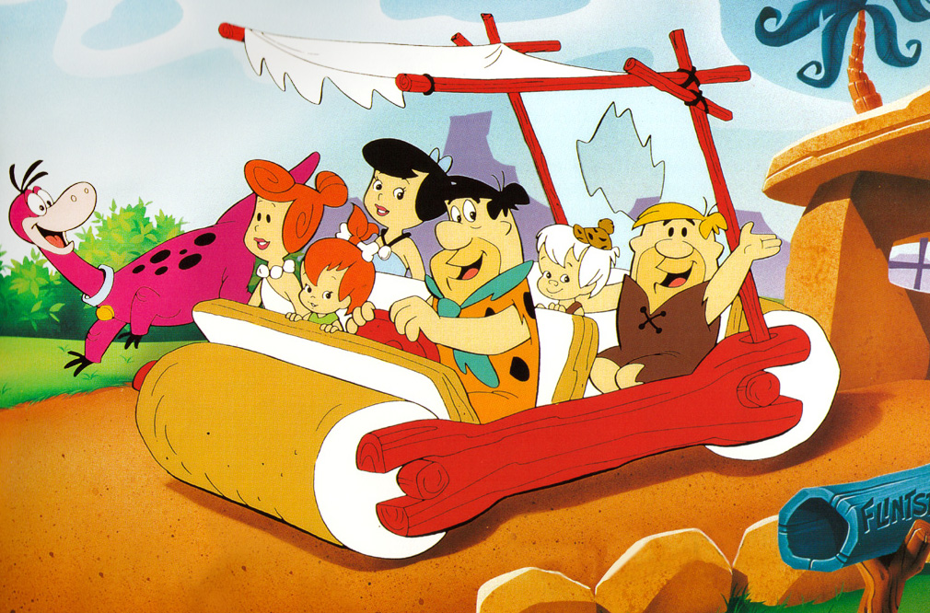
Introduction
THE FLINSTONES
THE JETSONS
Source: Daily Maverick
Source: Wikipedia
Supposedly set in 2062

Slide 7
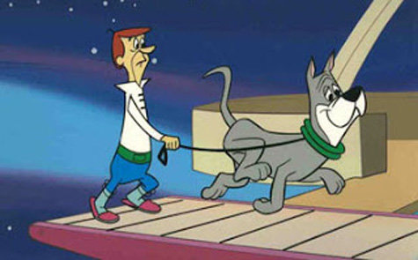
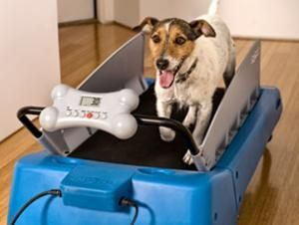
Introduction
“2062”
43 years earlier
Source: Criminalelement
Source: Amazon

Slide 8
Introduction
World population (1960-2016)
Life expectancy (1960-2016)
Source: Worldometers
Source: World Bank

Slide 9
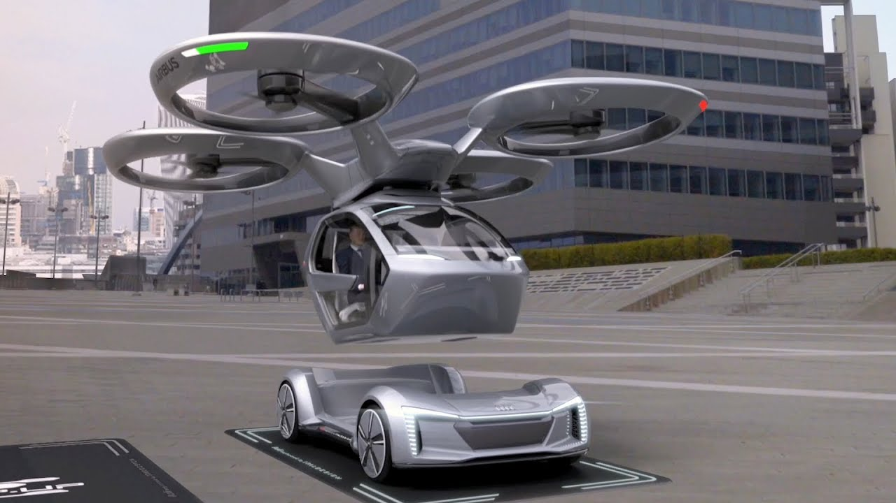
Introduction
Looking further into the future is essential
Companies that quickly evolve are those that will transcend and exploit the opportunity RESPONSIBILITY to serve future generations
Megatrends?
Source: El Comercio, Perú
Source: Youtube

Slide 10
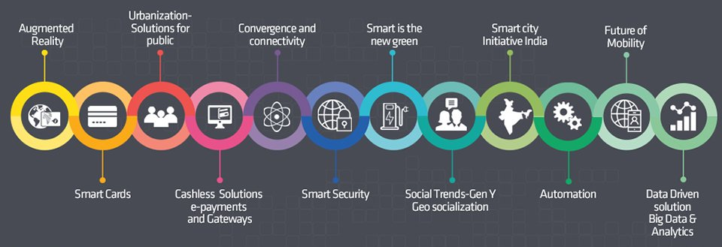
Megatrends
MT
“Global, sustained and macro economic forces of development that impact business, economy, society, cultures and personal lives thereby defining our future world and its increasing pace of change.”
Source: Nasscom

Slide 11
Why invest in Megatrends?
MT
By definition, they have the potential to grow above economic growth
 | Group 1 High growth |  |  |  |  | Group 1 (times)
Indicator | 92-97 | 97-07 | 07-18 |  | Ratio | 92 | 97 | 07 | 18
Sales | 35% | 11% | 6% |  | P/S | 2.9 | 3.7 | 4.1 | 4.9
Net income | 39% | 16% | 7% |  | P/E | 22.0 | 19.8 | 19.0 | 24.9
EBITDA | 39% | 11% | 8% |  | P/EBITDA | 13.1 | 13.7 | 18.8 | 19.6
Mkt Cap | 42% | 14% | 7%
 | Group 2 Medium growth |  |  |  |  | Grupo 2 (times)
Indicator | 92-97 | 97-07 | 07-18 |  | Ratio | 92 | 97 | 07 | 18
Sales | 12% | 9% | 4% |  | P/S | 2.0 | 2.5 | 2.1 | 2.9
Net income | 12% | 12% | 5% |  | P/E | 21.0 | 26.3 | 18.0 | 22.0
EBITDA | 13% | 10% | 5% |  | P/EBITDA | 10.6 | 11.9 | 9.6 | 11.5
Mkt Cap | 17% | 9% | 6%
Source: Own authorship

Slide 12
Why invest in Megatrends?
MT
It is always a “good story to tell”
The alternative:
Real interest rates (2000-2017)
Switzerland 3%
Italy 2.4%
USA 1.9%
Australia 1.5%
Japan1.2%
Mexico 1.1%
China 0.3%
Source: World Bank

Slide 13
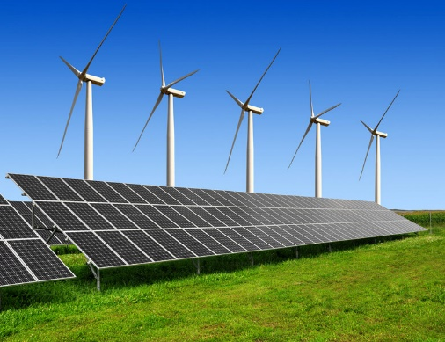
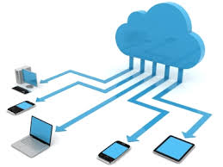
Defining the Megatrends
Urbanization
Smart cities
“Millenials”
Diversity
Rise of middle class
N11 (The next game changers): Philippines, South Korea, Vietnam, Bangladesh, Indonesia, Nigeria, Mexico…
Digitalization and Fintech
Outsourcing
Cloud computing
Satellite technology
Future consumer electronics
Virtual reality
Robotics
Social networking
Wireless intelligence
Top technologies and materials
Infraestructure development
Clean energies
Zero waste!
E-mobility
New business models
New education models
Source: HP
Source: Techworth
Source: Stanford
Source: HSI

Slide 14
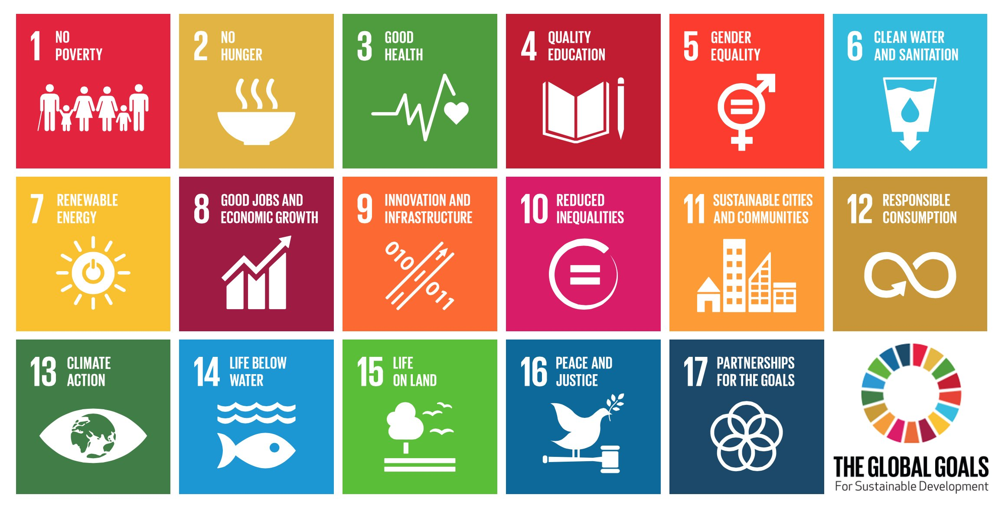
UN Sustainable Development Goals (UNSDGs)
Blueprint to achieve a more sustainable future for all. They interconnect and address the global challenges we face, including those related to poverty, inequality, climate, environmental degradation, prosperity, and peace and justice. Target: 2030
→ ESG factors
Source: UN SDGs

Slide 15
UN PRI
The 6 PRI are a voluntary aspirational possible actions for incorporating ESG issues into investment practice:
Incorporate ESG issues into investment analysis and decision-making
Be active owners and incorporate ESG into policies and practices
Seek appropriate disclosure on ESG issues by entities in which we invest
Promote acceptance and implementation
Work together to enhance the effectiveness
Report on our activities and progress towards implementation
Source: UN PRI

Slide 16
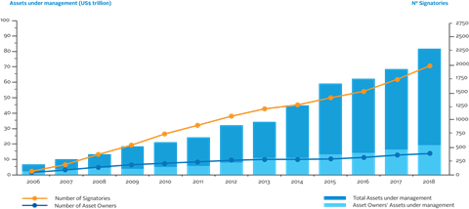
UN PRI
Source: UN PRI

Slide 17
Why ESG matters?
“If the world is to tackle global warming, vast amounts of money will have to flow into clean-energy generation.”
- The Economist (Verdant and vibrant: Green asset classes are proliferating)
“From 2014-2017, in the Eurozone, all pillars (Environmental, Social and Governance) displayed positive returns, with the Governance pillar dominating.”
- Amundi Asset Management (The Alpha and Beta of ESG Investing)
“The veteran money manager [Jeremy Grantham] will devote $1 bn to helping the world escape catastrophe.”
- Ben Steverman, Bloomberg (Investing Prophet Jeremy Grantham Takes Aim at Climate Change)
“The young are SRI’s big hope. In the coming decades, they will inherit pots of money. Unlike many of their baby-boomer parents, they believe in sustainable investing.”
- The Economist (Generation ISR: Sustainable investing joins the mainstream)

Slide 18
«Doing great by doing good»
ESG factors became popular not only as a “tree-hugger” matter, but as a relevant factor for investment analysis
ESG factors provide a better understanding of the management, a screening of regulatory risks and a projection of future appreciation of investments
They have proven to be important triggers of downsides to some stocks and bonds, and with good reason
Difficult to assess a number and quantify these risks
One truth: It does not hurt

Slide 19
Doing better by doing good
BJK (VanEck Vectors Gaming) and PBJ (Invesco Dynamic Food & Beverage) vs SUSA (MSCI USA ESG Select) and IQLT (Edge MSCI Intl Quality Fctr) 4y graph Source: Yahoo! Finance (last updated February 12th, 2019)

Slide 20
ESG factors do impact

Slide 21
ESG factors do impact

Slide 22
ESG factors do impact

Slide 23
Megatrends + ESG
Urbanization
Smart cities
“Millenials”
Diversity
Rise of middle class
N11 (The next game changers): Philippines, South Korea, Vietnam, Bangladesh, Indonesia, Nigeria, Mexico…
Digitalization and Fintech
Outsourcing
Cloud computing
Satellite technology
Future consumer electronics
Virtual reality
Robotics
Social networking
Wireless intelligence
Top technologies and materials
Infraestructure development
Clean energies
Zero waste!
E-mobility
New business models
New education models
Source: HP
Source: Techworth
Source: Stanford
Source: HSI

Slide 24
Megatrends + ESG
It is not enough to have the most advanced technology
Technological progress comes with a dark side where good ideas may produce undesirable results (extreme downsides include atomic and biological weapons)
Increasingly important that these technological advances are managed ethically and for the welfare of society
Target: Achieve a Megatrend return with ESG Risk Management
Conviction in growth + ESG audit

Slide 25
Megatrends + ESG
Source: Fidentiis Gestión
Source: Fidentiis Gestión

Slide 26
THANK YOU!
Fernanda Salas fsalas@vitalis.com.mx

